Slide 1
8x8 Contact Center
Partner Implementation Guide

Slide 2
Welcome to the Channel Partner Guidelines for the 8x8 Contact Center Campaign. This document provides you with strategic guidance and marketing assets to execute touches 4-9 of the campaign in a turnkey manner.
Contents:
Campaign overview
Campaign creative and content
Emails
Social banners
Landing pages
Implementation guidelines
8x8 Contact Center Campaign
‹#›

Slide 3
8x8 Contact Center
Content & Promotional Assets
Content Assets
[White Paper] Proving the Value of a Collaborative Approach for Your Contact Center
[Webcast] Adapting to a Remote Workforce
[White Paper] The ROI of Uniting Unified Communications and Contact Center
[Webcast] Engaging a Remote Workforce
[eBook] 8 Contact Center Trends to Watch in 2020
[Webcast] Thriving as a Remote Workforce
Promotional Assets
[Social Cards] 6 versions of social cards to be used on partner social media channels
[Email] 6 versions of HTML emails with email copy/banners included
[Landing Page] 6 versions of HTML landing pages with iframe code
8x8 Contact Center Campaign

Slide 4
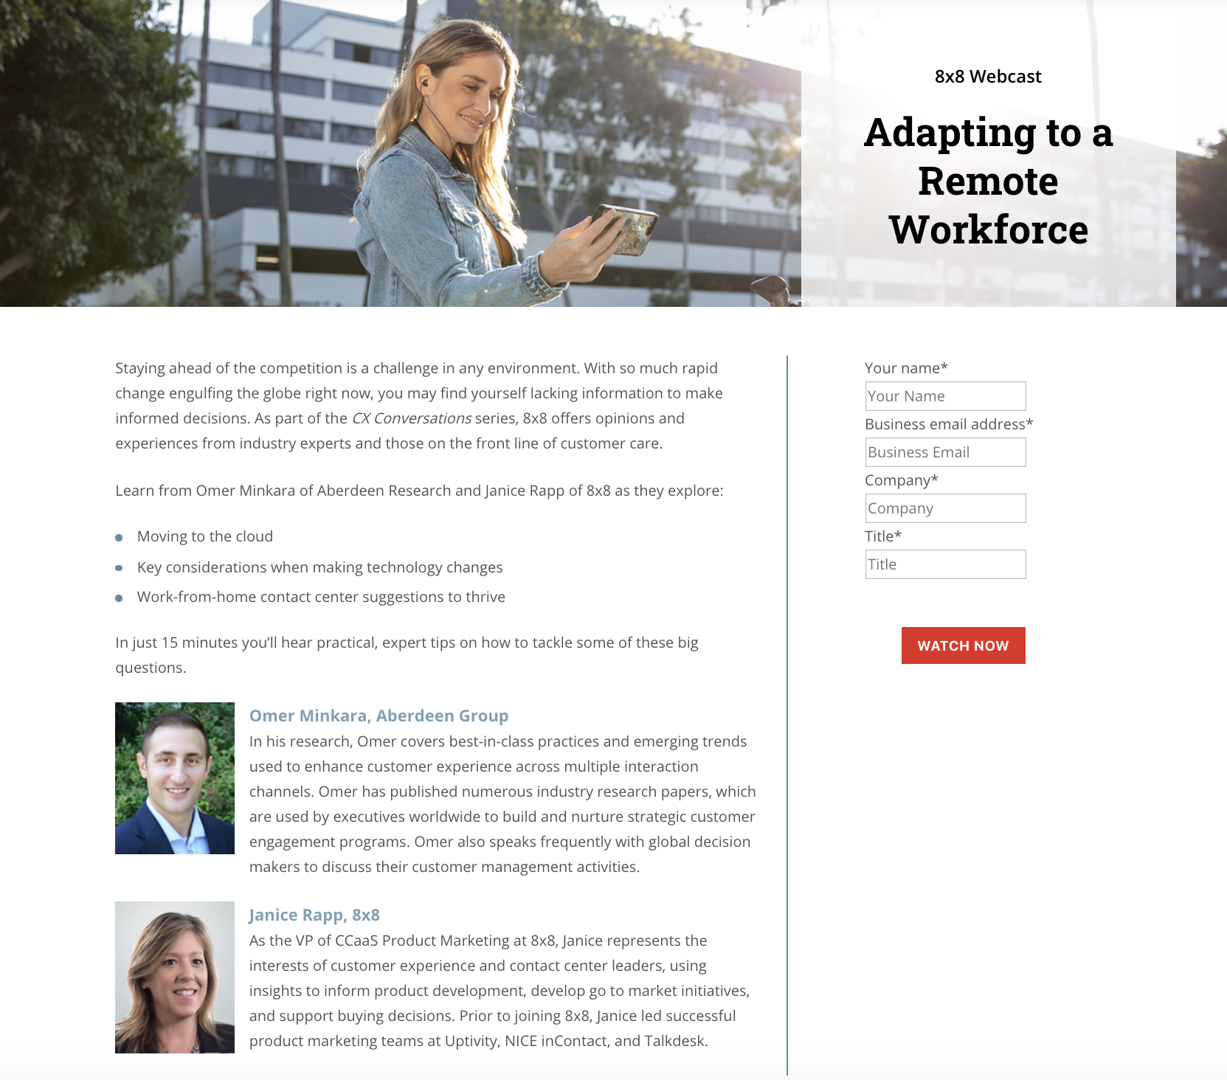
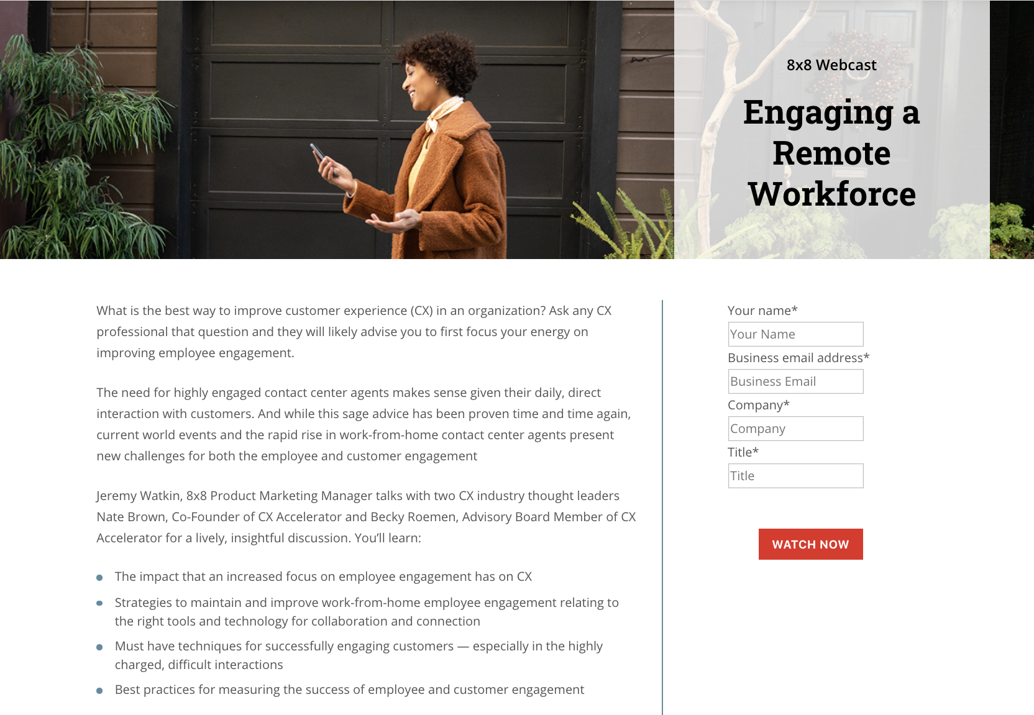
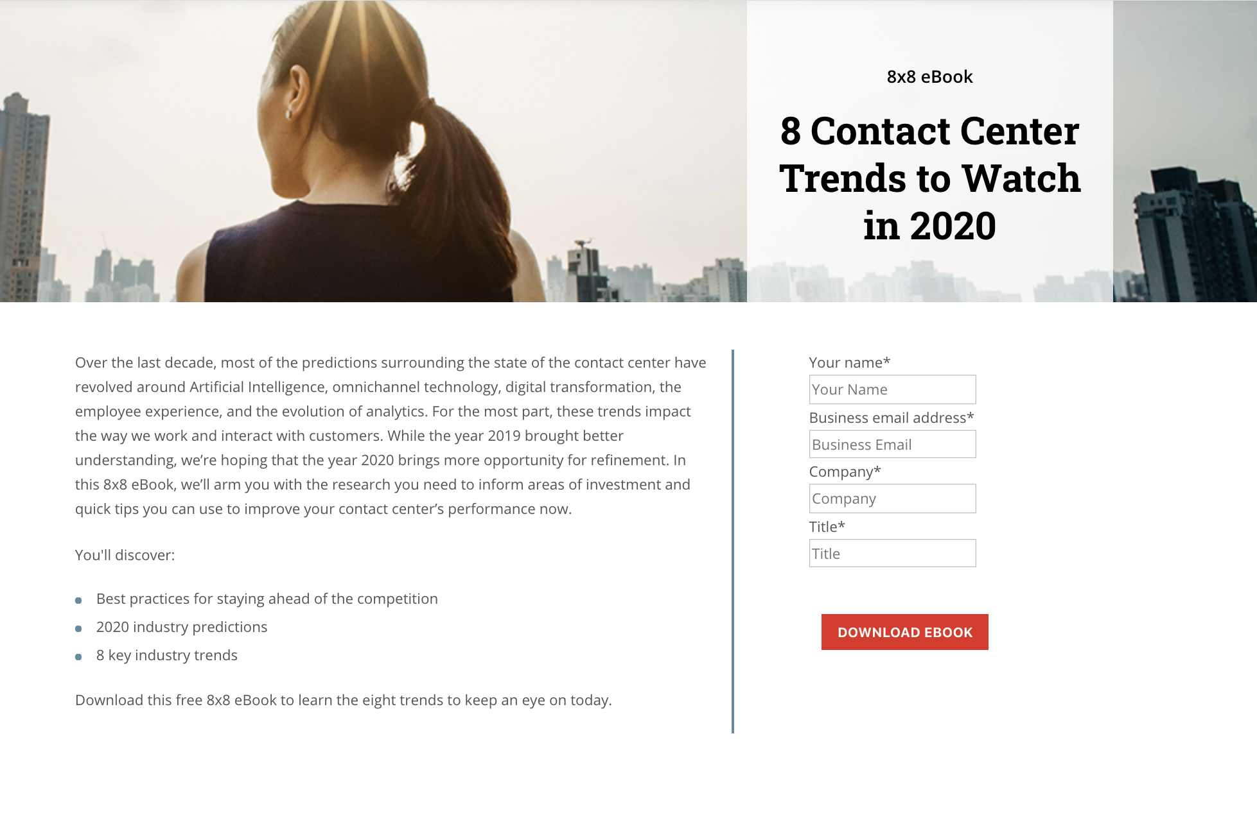
8x8 Contact Center
Channel Content & User Flow
Email
Touch
4
Email
Touch
5
Email
Touch
6
Email
Touch
7
Email
Touch
8
Email
Touch
9
[White Paper]
Proving the Value of a Collaborative Approach for Your Contact Center
[Webcast]
Adapting to a Remote Workforce
[White Paper]
The ROI of Uniting Unified Communications and Contact Center
[Webcast]
Engaging a Remote Workforce
[eBook]
8 Contact Center Trends to Watch in 2020
[Webcast]
Thriving a Remote Workforce
8x8 Contact Center Campaign

Slide 5
8x8 Contact Center
Campaign Planner
Package #2 Pre-Launch | Package #2 Launch Week | Week 5 | Week 6
Upload the list of contacts for this campaign to your email service. Create and test each of the 6 landing pages. Compose Email 4. Test the email format and hyperlink. | Send Email 4. Recommend sending early AM, Tues-Thurs. Monitor email opens, clicks and downloads. Compose Email 5. Test the email format and hyperlink. Launch banner ads and social posts. | Send Email 5. Recommend sending early AM, Tues-Thurs. Monitor email opens, clicks and downloads. Compose Email 6. Test the email format & hyperlink. | Send Email 6. Recommend sending early AM, Tues-Thurs. Monitor email opens, clicks and downloads. Compose Email 7. Test the email format & hyperlink
8x8 Contact Center Campaign

Slide 6
8x8 Contact Center
Campaign Planner
Week 7 | Week 8 | Week 9 | Package #2 Post-Launch
Send Email 7. Recommend sending early AM, Tues-Thurs. Monitor email opens, clicks and downloads. Compose Email 8. Test the email format & hyperlink | Send Email 8. Recommend sending early AM, Tues-Thurs. Monitor email opens, clicks and downloads. Compose Email 9. Test the email format & hyperlink | Send Email 9. Recommend sending early AM, Tues-Thurs. Monitor email opens, clicks and downloads. | Tally the engagement (opens, clicks and downloads) across all 6 emails. Call the most engaged contacts to secure an appointment. The general rule is to call all contacts who have 2 or more downloads, 2 or more opens and at least 1 download.

Slide 7
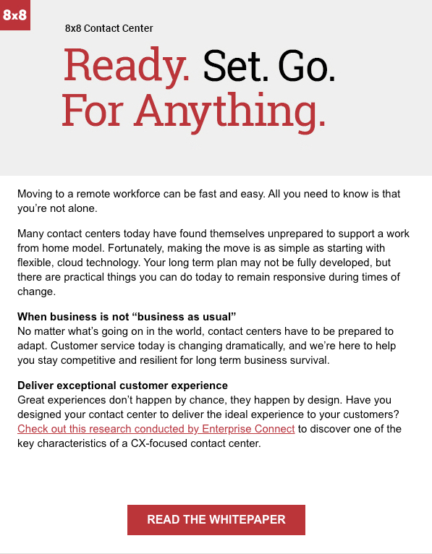
Email - Touch 4 - Proving the Value of a Collaborative Approach
8x8 Contact Center Campaign

Slide 8
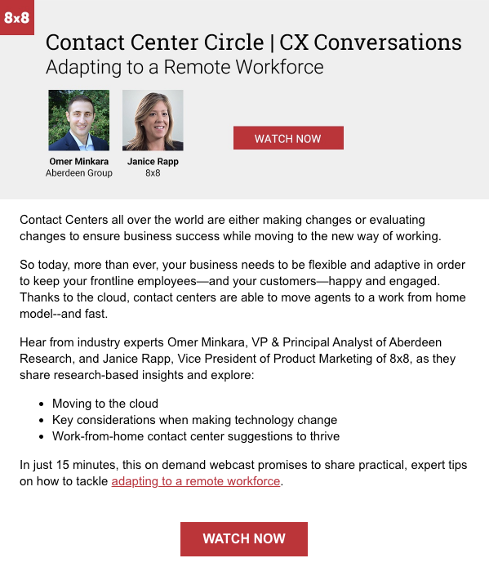
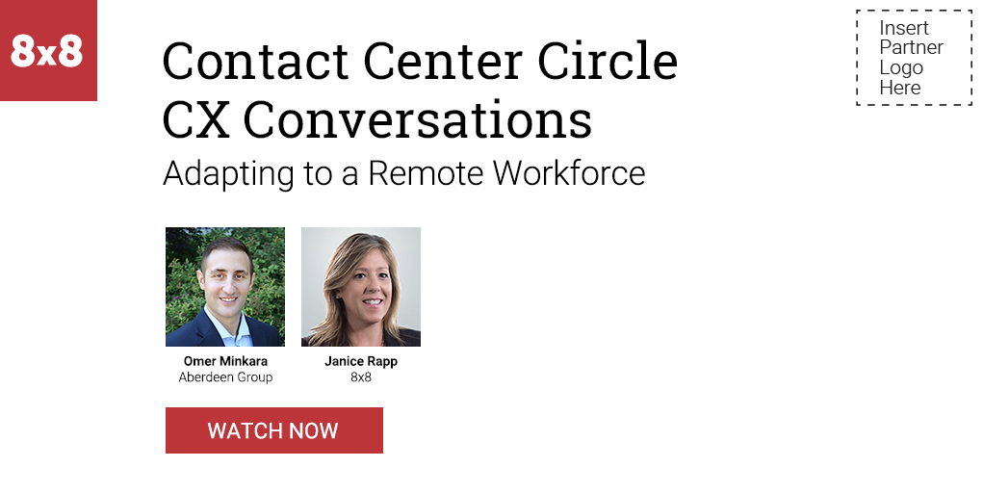
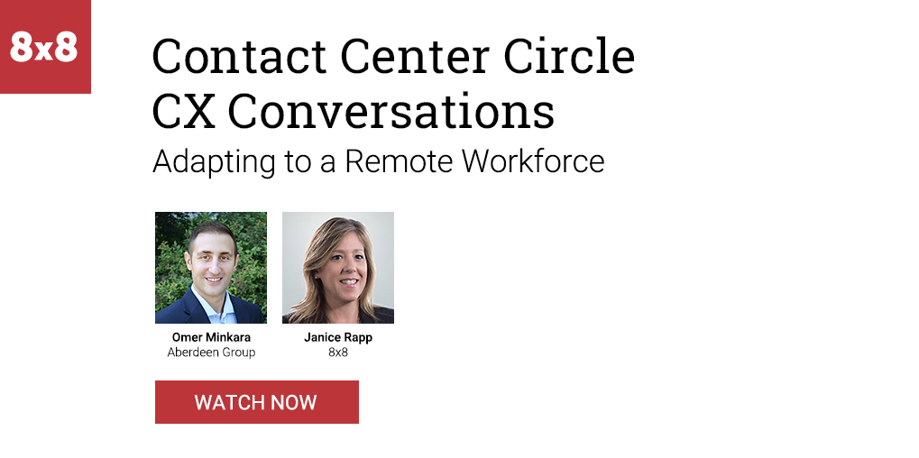
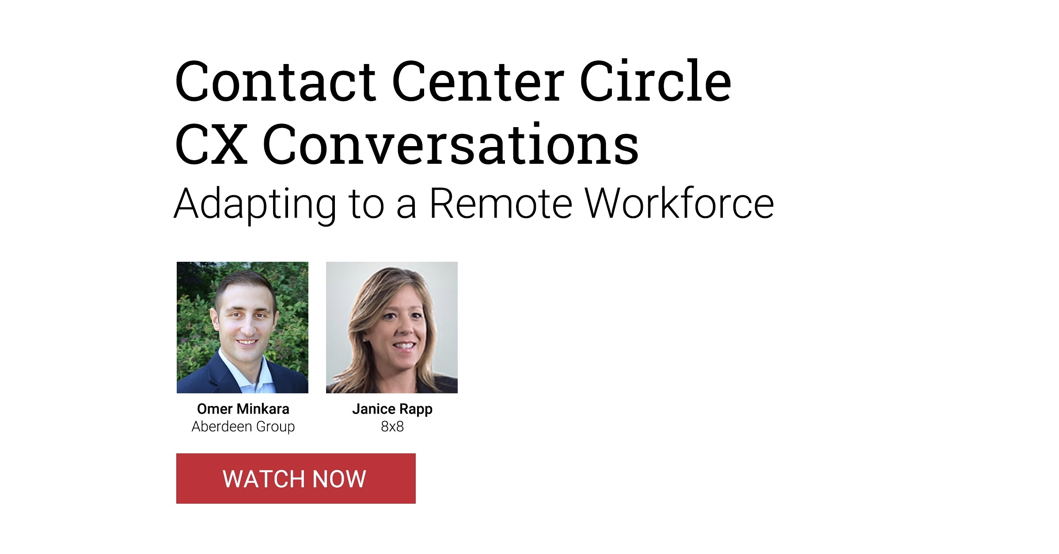
Email - Touch 5 - Adapting to a Remote Workforce
8x8 Contact Center Campaign

Slide 9
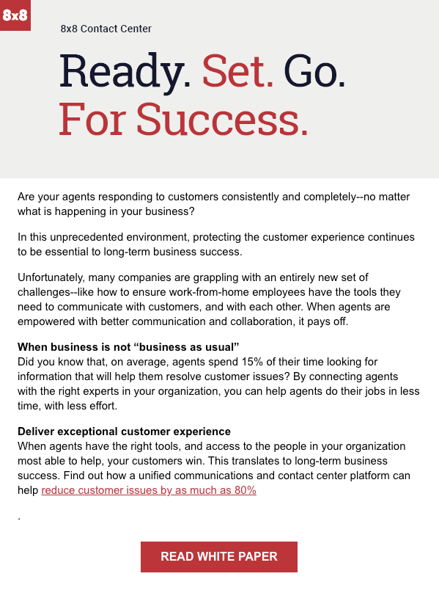
Email - Touch 6 - Uniting Unified Communications and Contact Center
8x8 Contact Center Campaign

Slide 10
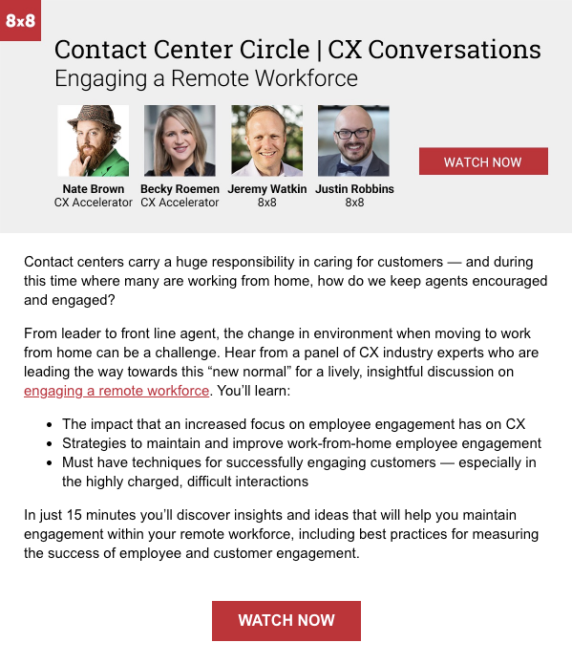
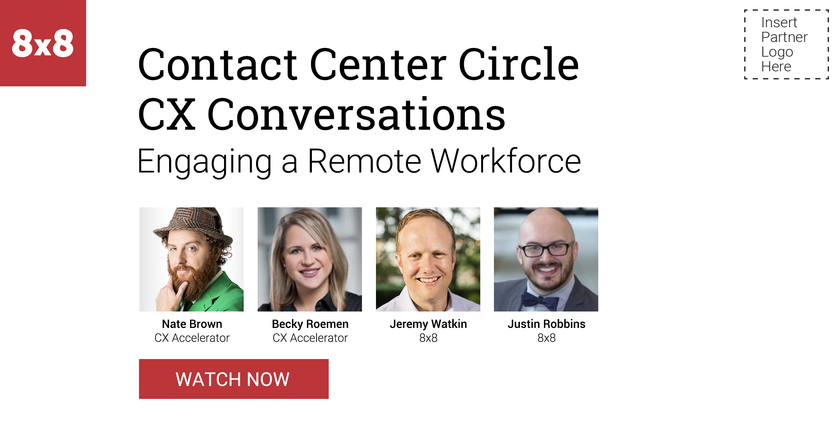
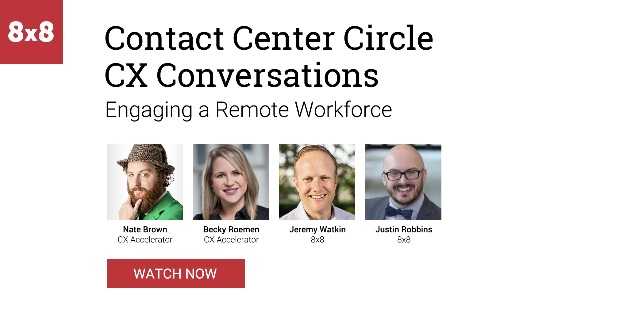
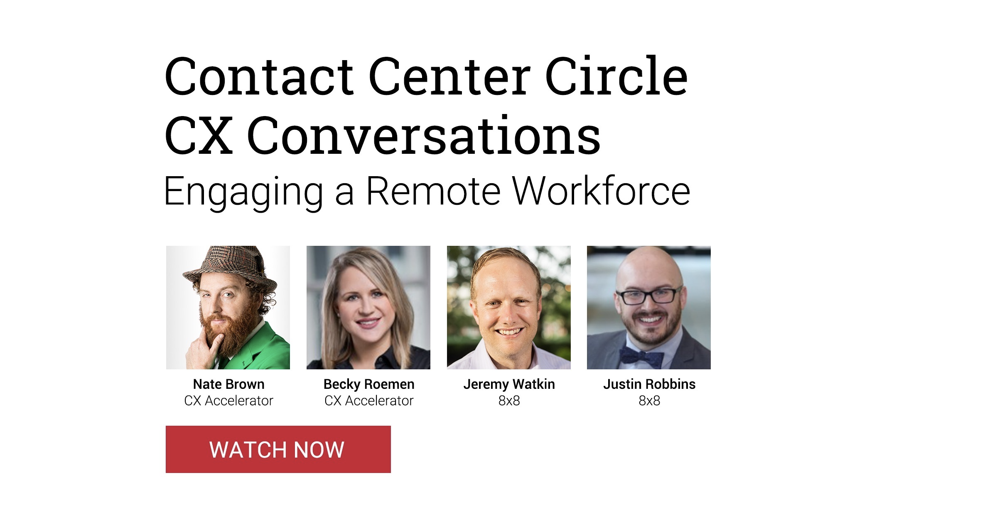
Email - Touch 7 - Engaging a Remote Workforce
8x8 Contact Center Campaign

Slide 11
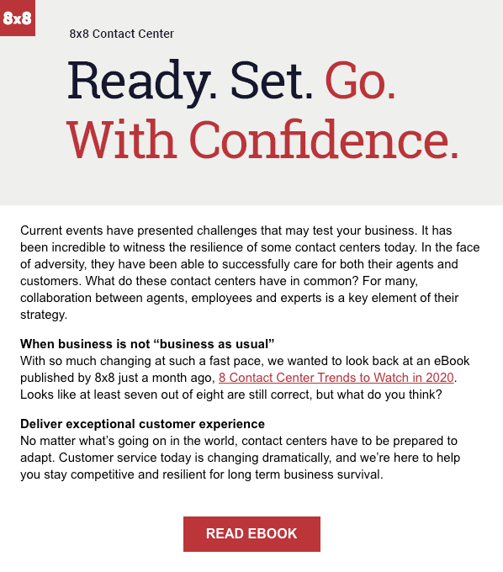
Email - Touch 8 - Contact Center Trends to Watch in 2020
8x8 Contact Center Campaign

Slide 12
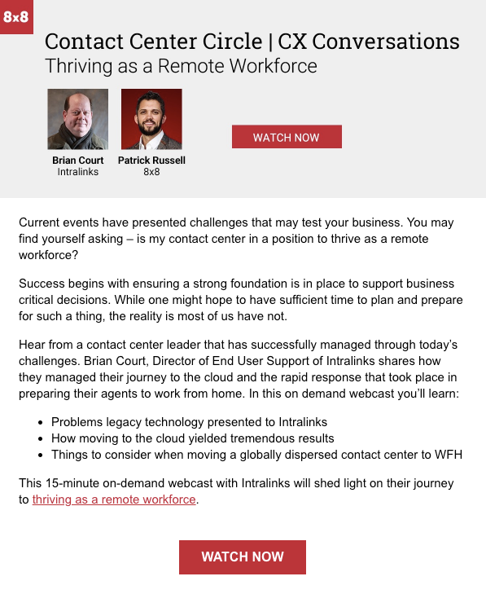
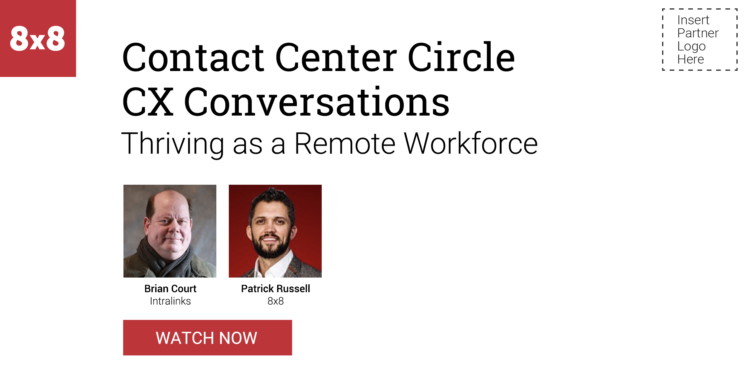
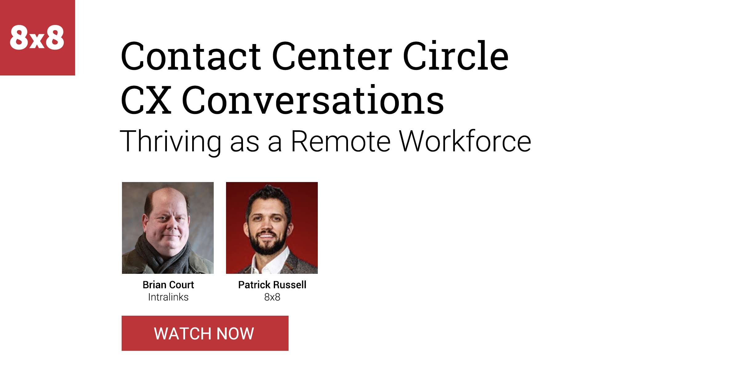
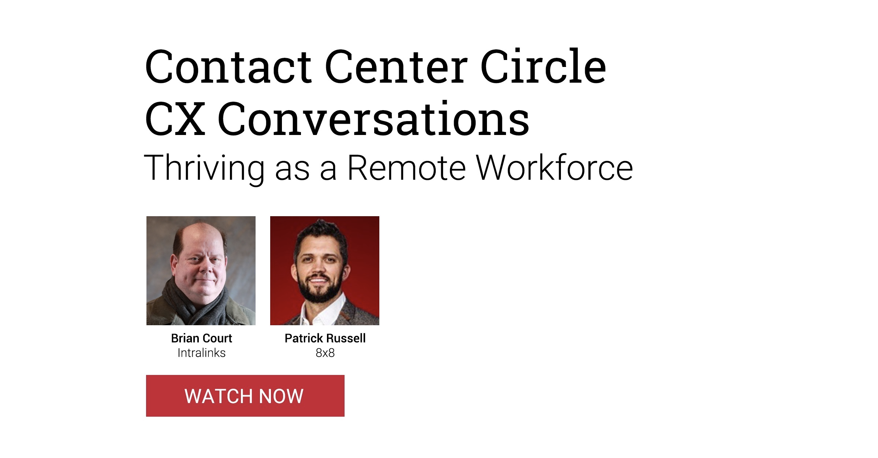
Email - Touch 9 - Thriving as a Remote Workforce
8x8 Contact Center Campaign

Slide 13
8x8 Contact Center
Campaign Creative
8x8 Contact Center Campaign

Slide 14
Creative Assets - Touch 4 - Proving the Value White Paper

Slide 15
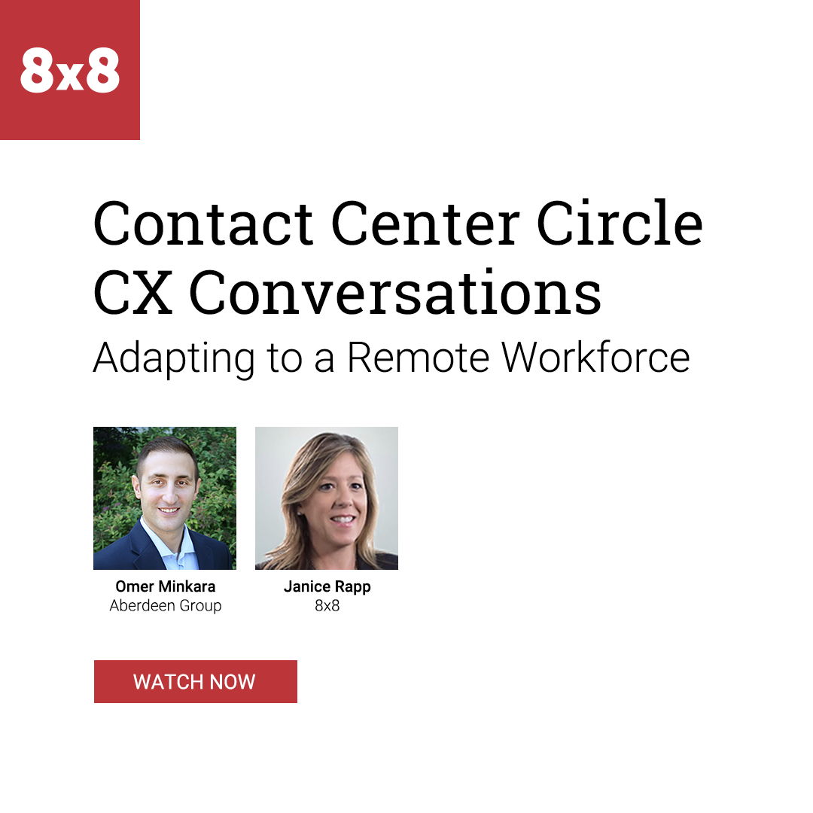
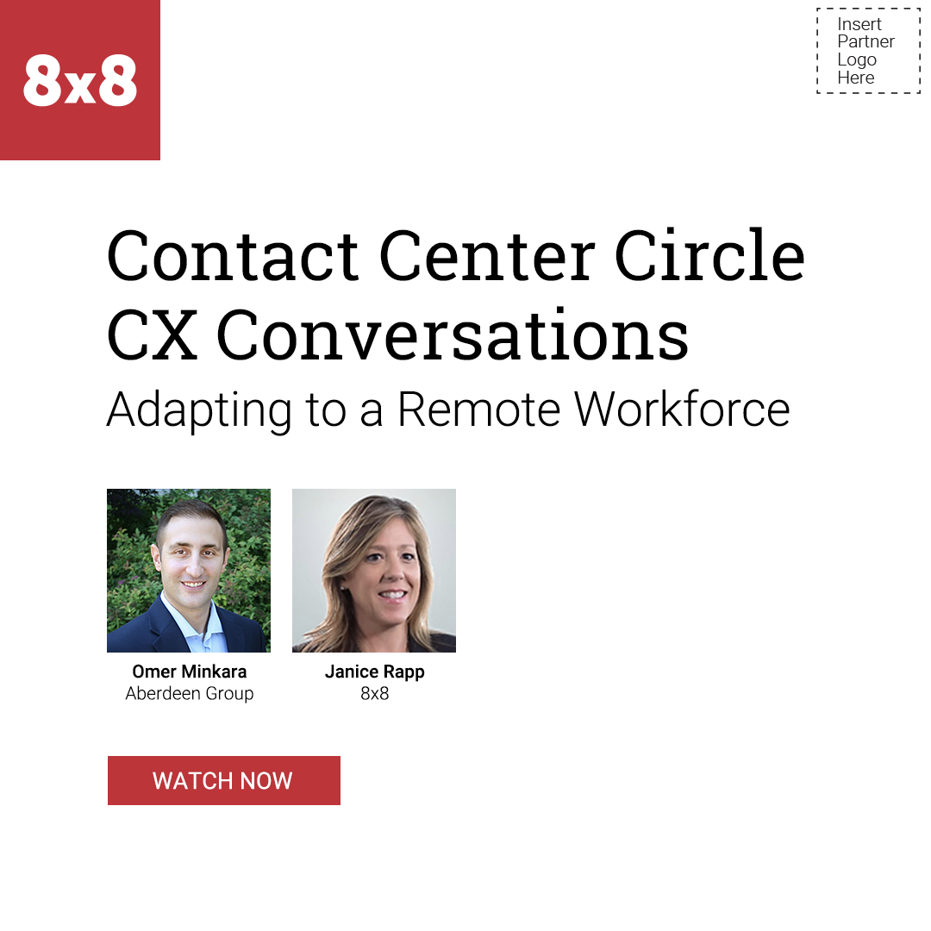
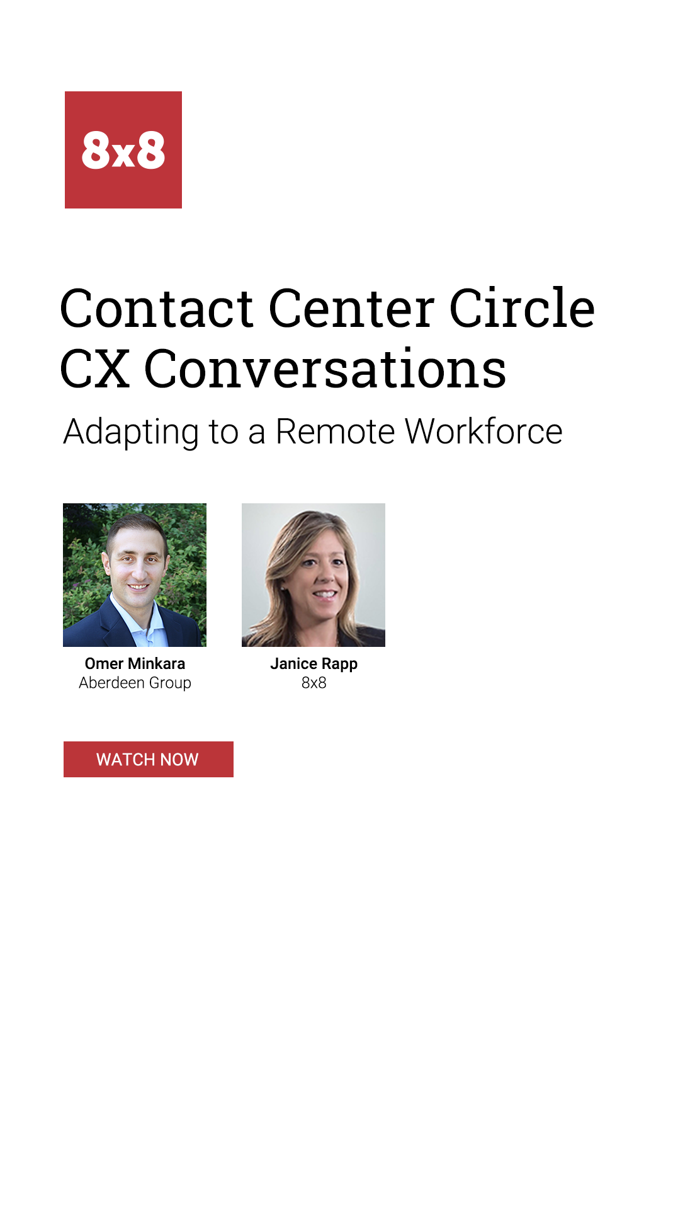
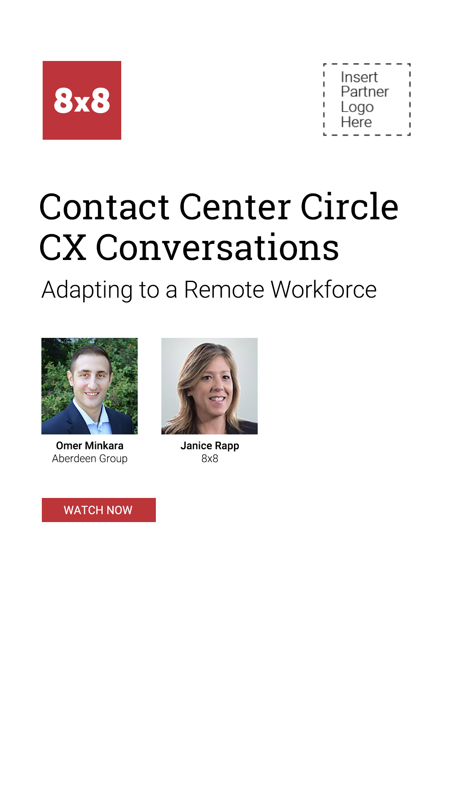
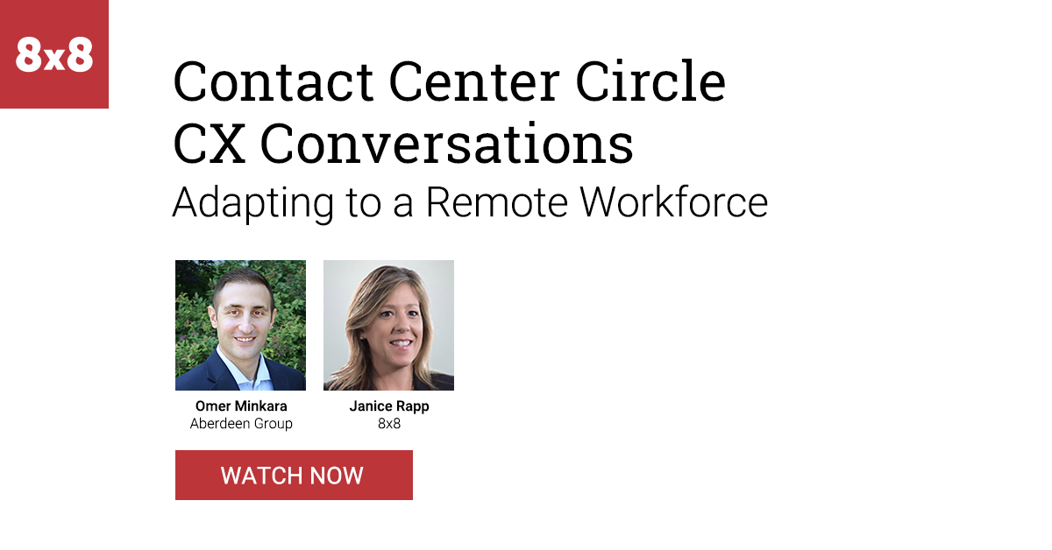
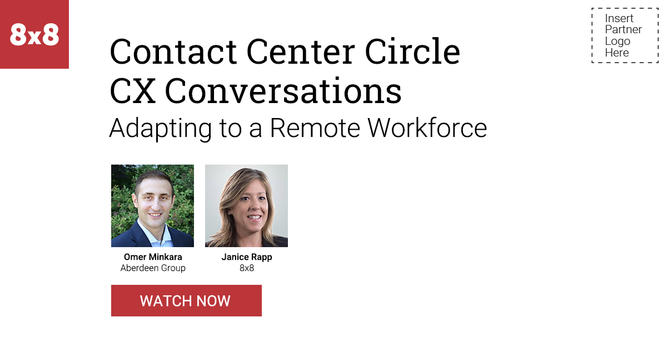
Creative Assets - Touch 5 - Adapting Webcast

Slide 16
Creative Assets - Touch 6 - Uniting UC & CC White Paper

Slide 17
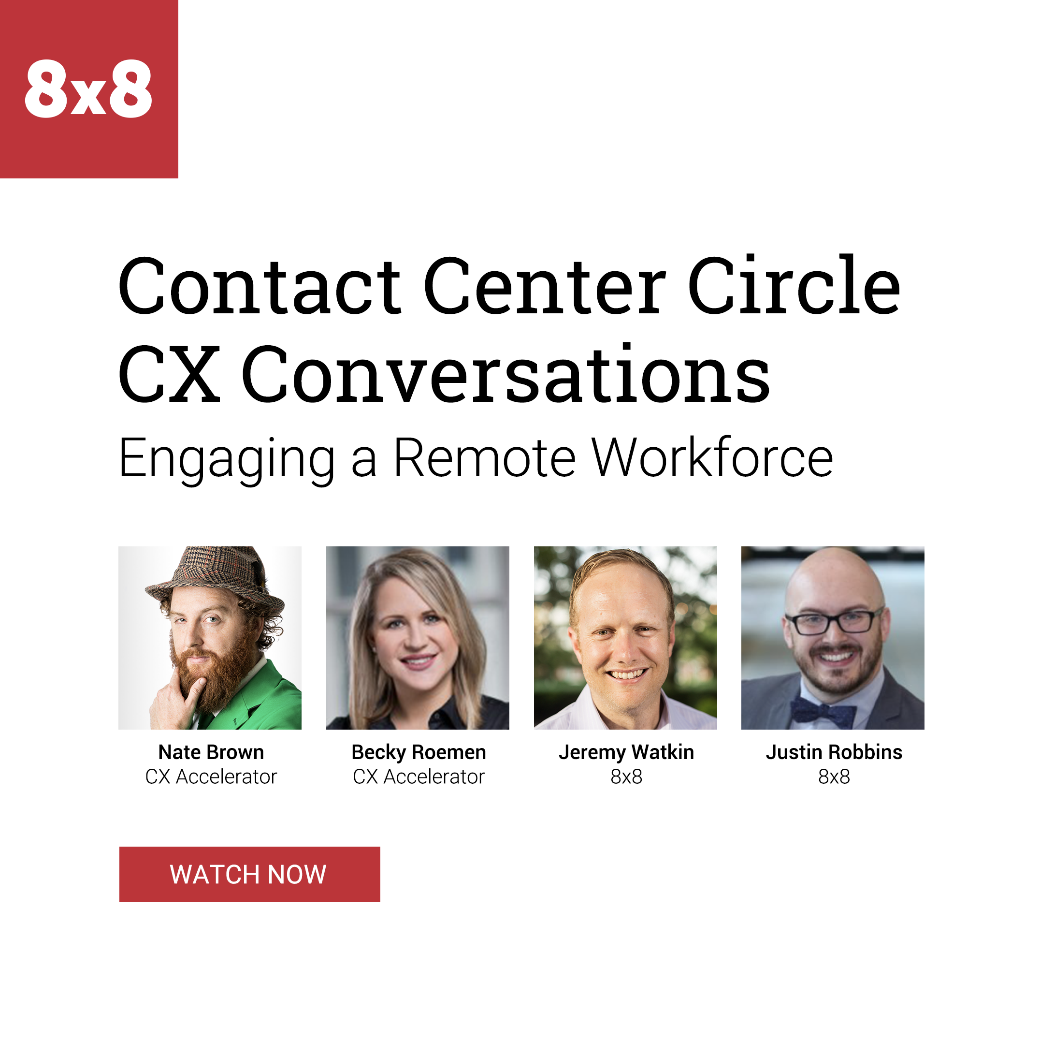
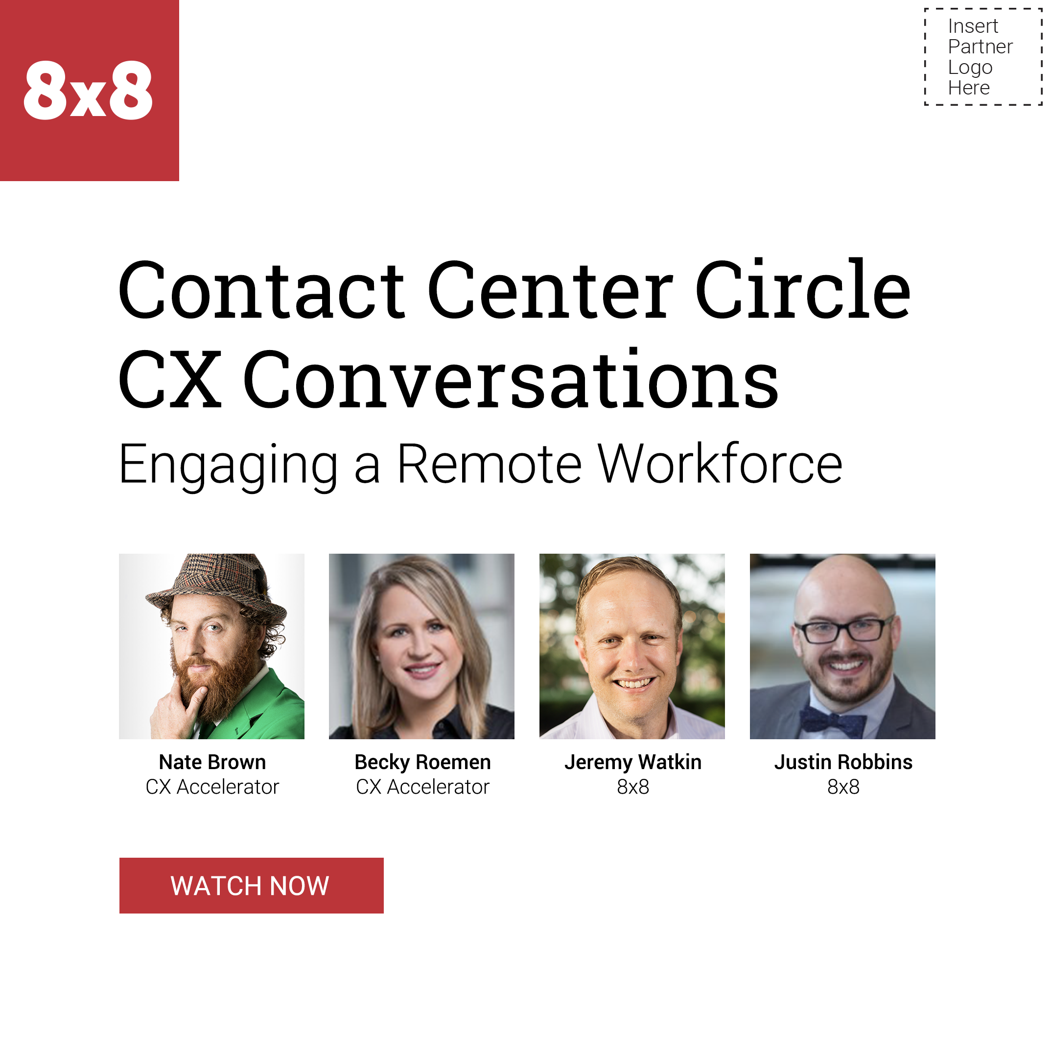
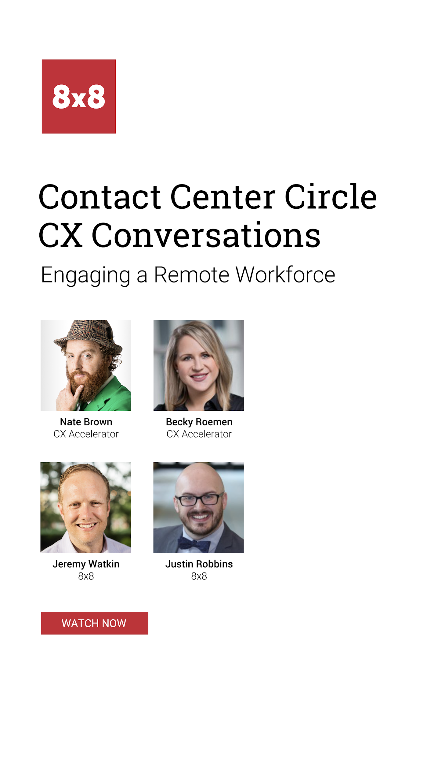
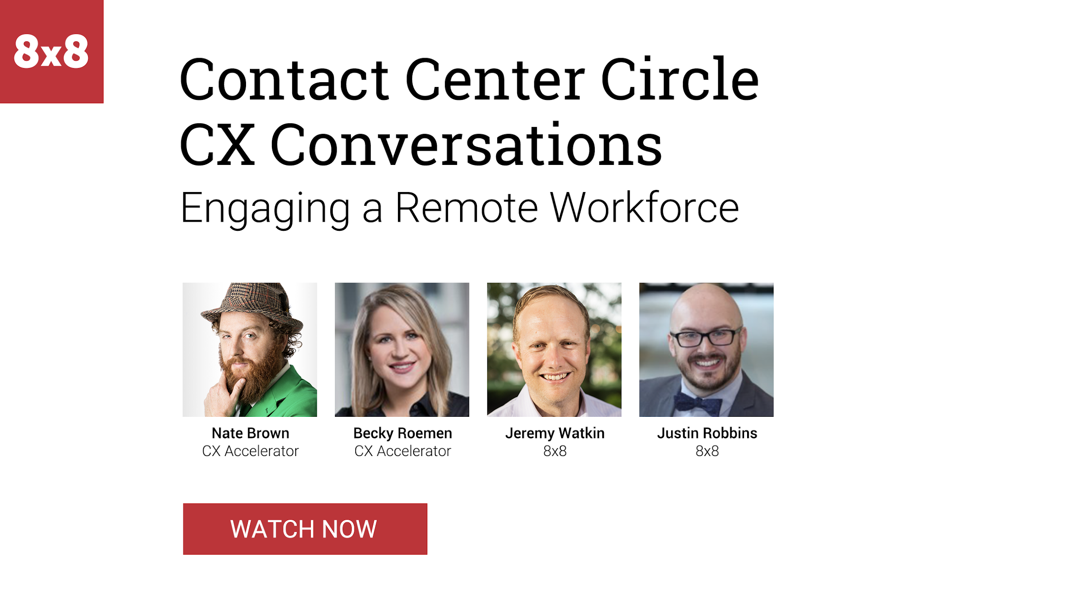
Creative Assets - Touch 7 - Engaging Webcast

Slide 18
Creative Assets - Touch 8 - Contact Center Trends eBook

Slide 19
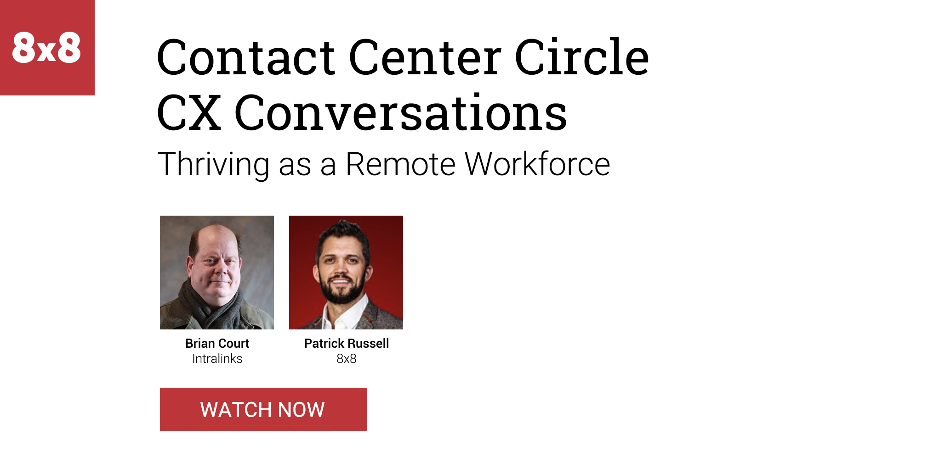
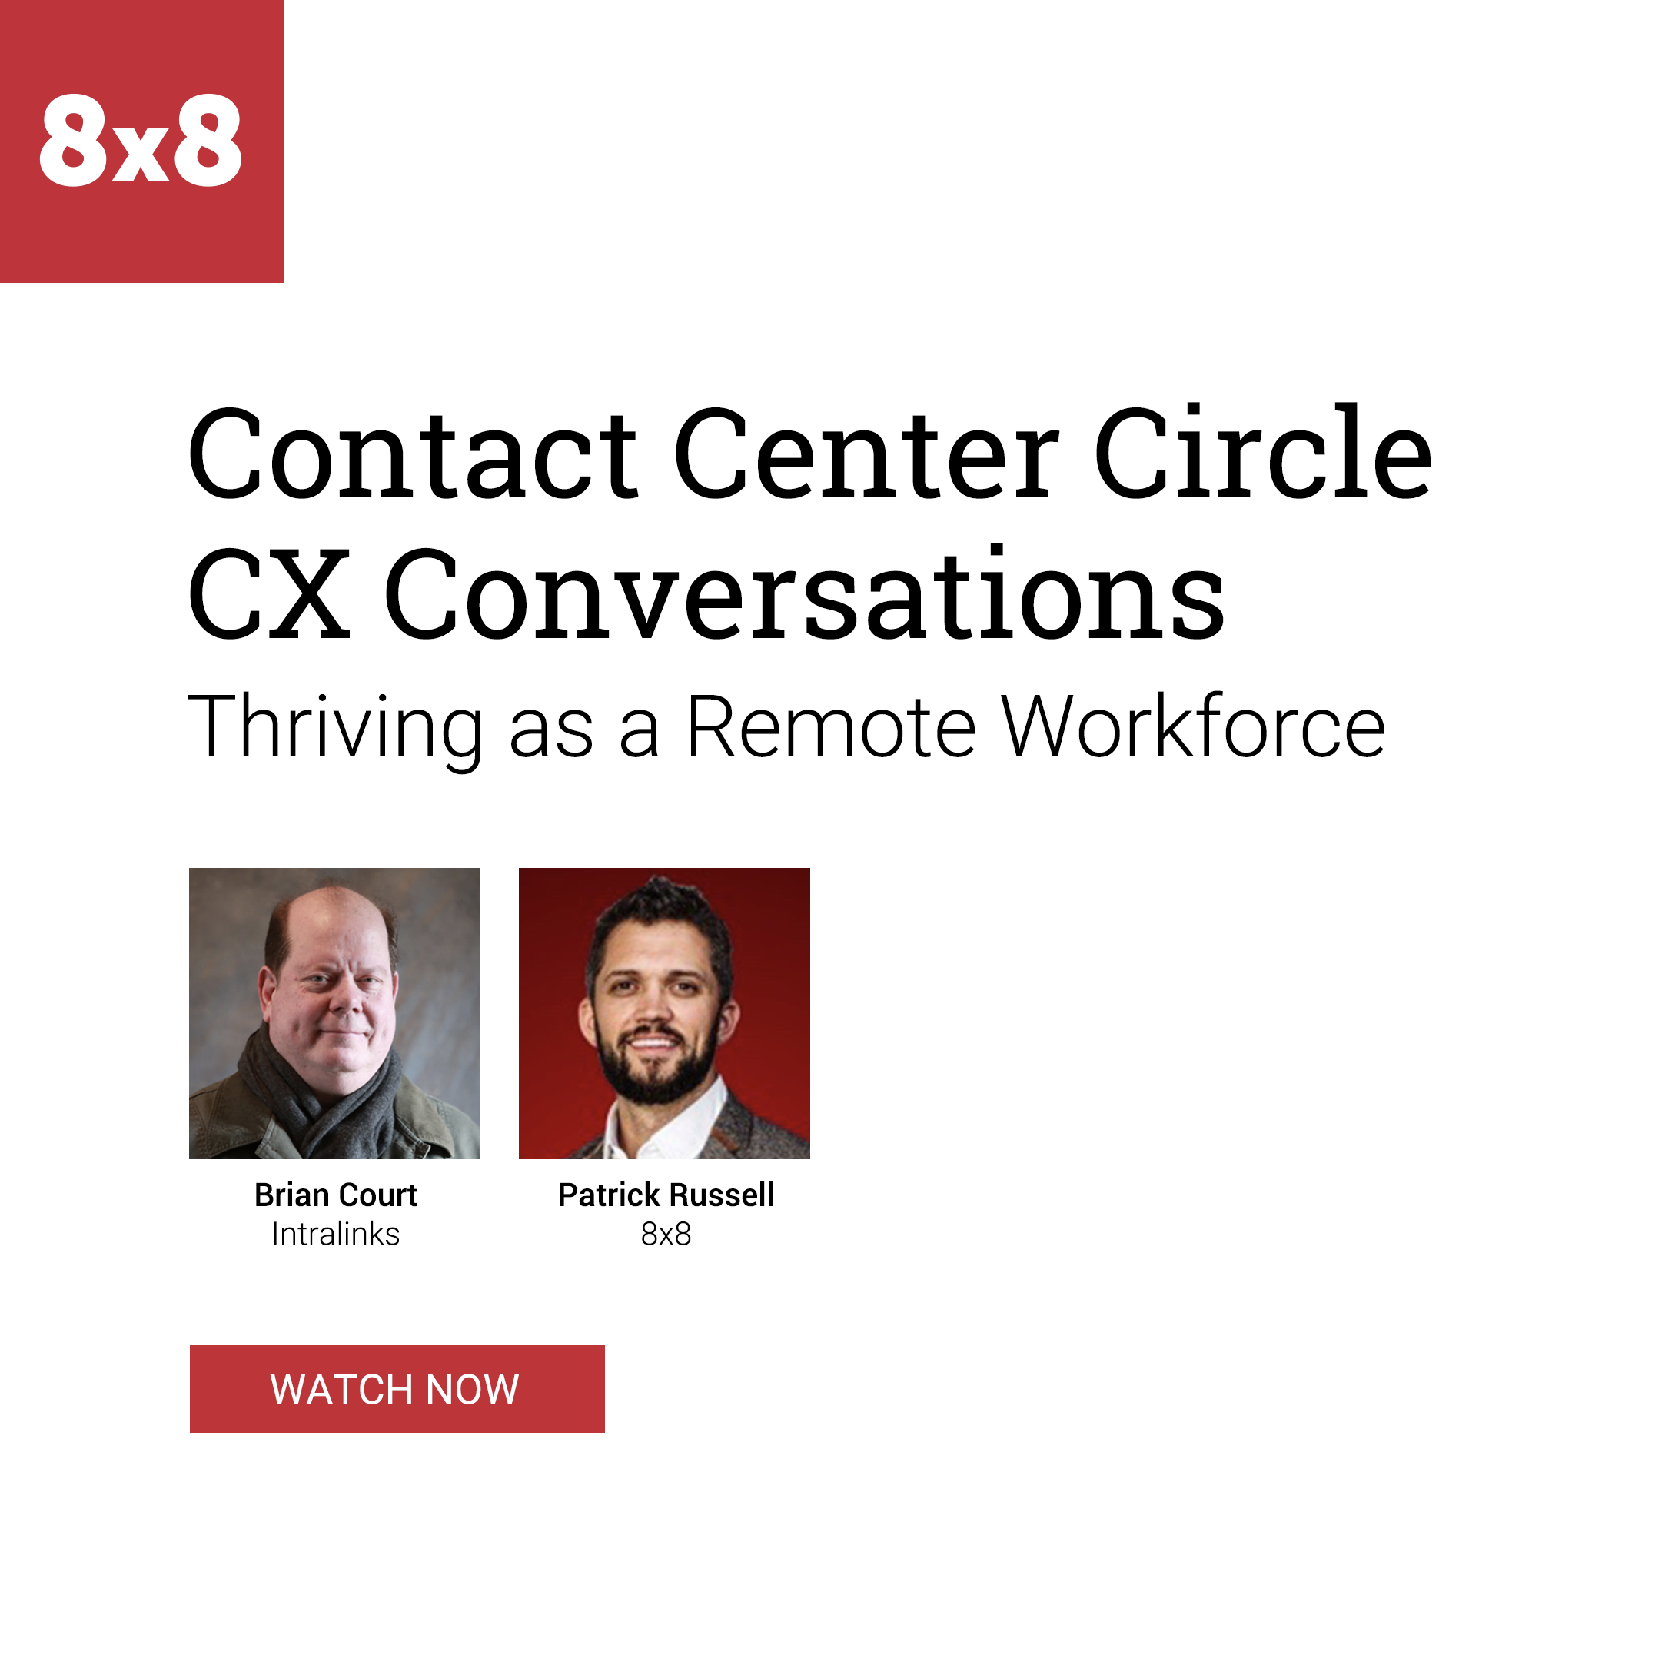
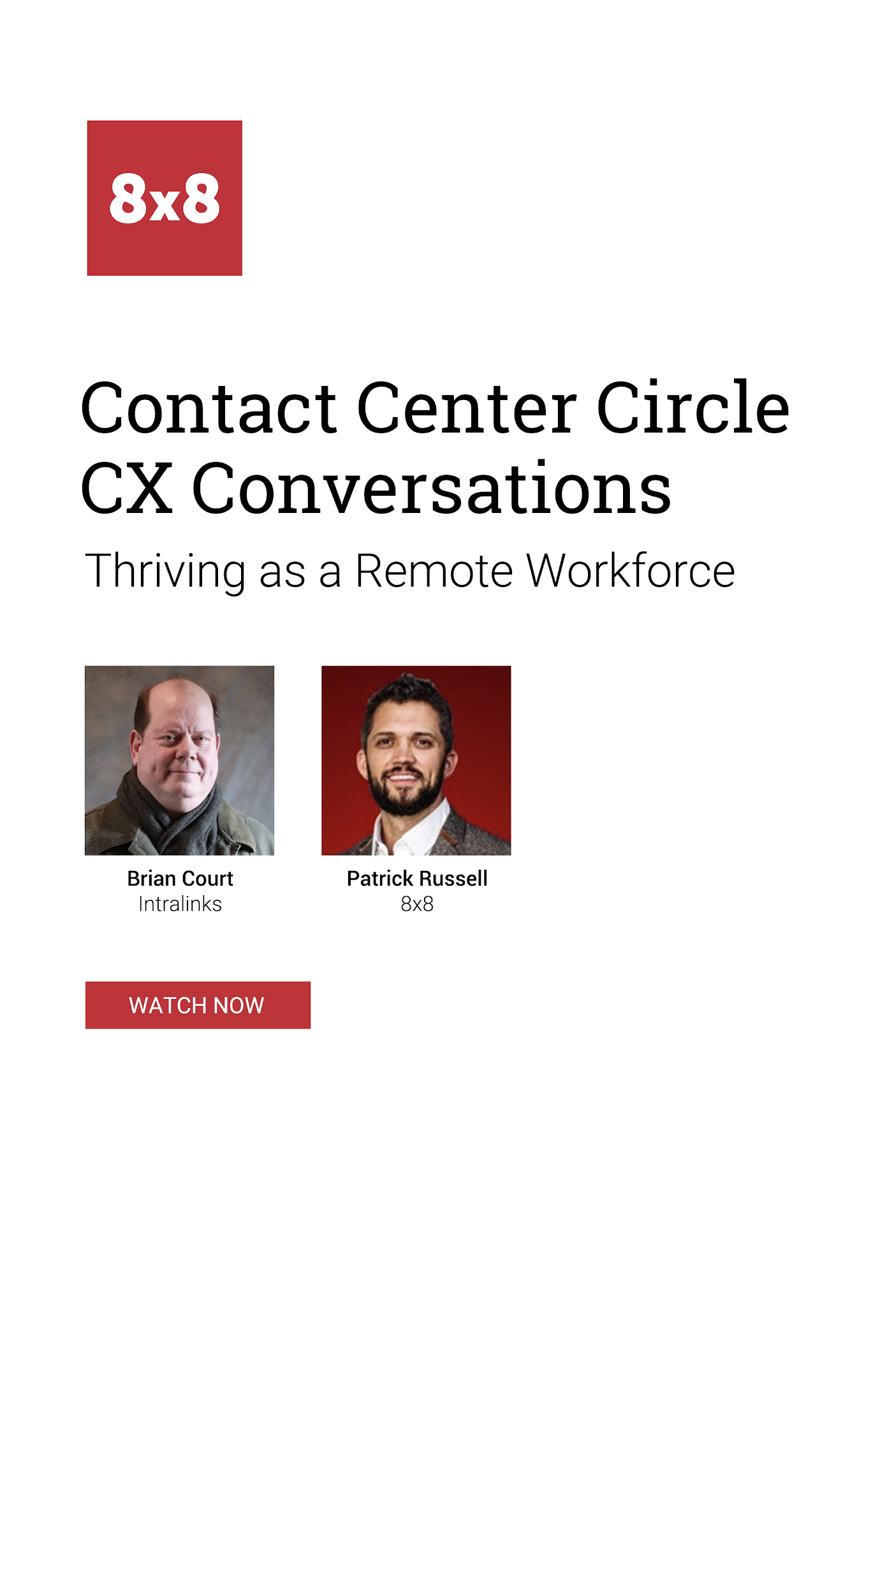
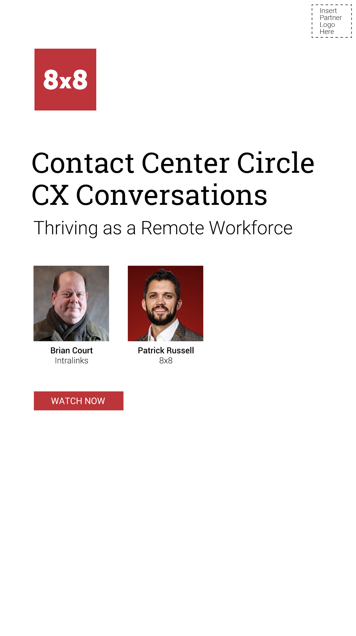
Creative Assets - Touch 9 - Thriving Webcast

Slide 20
8x8 Contact Center
Implementation Guidelines
8x8 Contact Center Campaign

Slide 21
8x8 Contact Center
HTML Email Instructions
General Instructions
All emails are graphic HTML emails designed to capture the reader’s attention. Other than the limited edits identified below, no changes should be made to the design layout, images or the HTML code.
Edit #1 - Co-branding and logo placement
Each email has a block for you to add your company logo and contact information. The layout for this block should remain consistent across all emails with the logo on the right side.
Edit #2 – Customizing the embedded hyperlinks
The image block for your logo has a placeholder for you to embed a link back to your home page. Additionally, the CTA (Call-to-Action) button links in the emails must be replaced with a link to the landing page.
Edit #3 – Update footer
Replace email footer at the very bottom of HTML and replace with your company information.
Note that the above changes should be performed by someone skilled in creating and editing HTML emails so as not to break any of the surrounding code. Each email has comments surrounding the lines to be edited. Once the edits have been completed and successfully tested, these comments should be deleted to ensure they don’t impact your deliverability to the inbox.
8x8 Contact Center Campaign

Slide 22
8x8 Contact Center
Landing Page Implementation Instructions
The landing pages are designed to be integrated into your website so your branding is preserved. It is also designed to alert you via email each time a visitor downloads one of the assets. You will need to provide your webmaster with the email address where you want these alerts to be delivered.
Your webmaster will need to create and test these landing pages before the emails are scheduled to be sent out. There are 2 indicators the test was successful:
The entire landing page is displayed properly with no scroll bars.
The alert email arrives in your designated email box shortly after you’ve downloaded the asset.
8x8 Contact Center Campaign

Slide 23
8x8 Contact Center
Webmaster Instructions
The HTML code for the iframe landing pages can be found on the next three (3) slides. The items displayed in red will need to be edited:
SIZE
The iframe will display properly without scrollbars when the width is set to 1200 and the height is set to 1750. The form is responsive so you can set the iframe to a narrower width if necessary.
At narrower widths, the height may need to be changed to 2300 to prevent scrollbars from reappearing.
EMAIL PARAM
The email address should be updated to the address provided by your sales team.
Important Note: The email address must be formatted as plain text (yourmailbox@mailserverdomain.com). The email server cannot send notices to email addresses that have been encoded. Please conduct several tests to ensure you are successfully receiving the notification emails each time the web form is completed.
8x8 Contact Center Campaign

Slide 24
iFrame Code: Landing Page 4
Proving the Value of a Collaborative Approach White Paper
Landing Page 4 – Proving the Value of a Collaborative Approach to Your Contact Center
The section displayed in red will need to be edited to the address you would like to receive notifications.
<iframe src="https://www.8x8.com/8/work-remotely-v1-ec-research-collaborative-approach-to-your-contact-center-white-paper?email=name@domain.com" name="frame1" scrolling="yes" frameborder="no" align="center" width="1200" height="1750" ></iframe>
8x8 Contact Center Campaign

Slide 25
iFrame Code: Landing Page 5
Adapting to a Remote Workforce Webcast
Landing Page 5 – Adapting to a Remote Workforce Webcast
The section displayed in red will need to be edited to the address you would like to receive notifications.
<iframe src="https://www.8x8.com/8/work-remotely-v1-adapting-to-a-remote-workforce-webinar?email=name@domain.com" name="frame1" scrolling="yes" frameborder="no" align="center" width="1200" height="1750" ></iframe>
8x8 Contact Center Campaign

Slide 26
iFrame Code: Landing Page 6
The ROI of Uniting Unified Communications and Contact Center White Paper
Landing Page 6 – The ROI of Uniting Unified Communications and Contact Center White Paper
The section displayed in red will need to be edited to the address you would like to receive notifications.
<iframe src="https://www.8x8.com/8/work-remotely-v1-roi-uniting-unified-communications-contact-center-white-paper?email=name@domain.com" name="frame1" scrolling="yes" frameborder="no" align="center" width="1200" height="1750" ></iframe>
8x8 Contact Center Campaign

Slide 27
iFrame Code: Landing Page 7
Engaging a Remote Workforce Webcast
Landing Page 7 – Engaging a Remote Workforce Webcast
The section displayed in red will need to be edited to the address you would like to receive notifications.
<iframe src="https://www.8x8.com/8/work-remotely-v1-engaging-a-remote-workforce-webinar?email=name@domain.com" name="frame1" scrolling="yes" frameborder="no" align="center" width="1200" height="1750" ></iframe>
8x8 Contact Center Campaign

Slide 28
iFrame Code: Landing Page 8
8 Contact Center Trends to Watch in 2020
Landing Page 8 – 8 Contact Center Trends to Watch in 2020
The section displayed in red will need to be edited to the address you would like to receive notifications.
<iframe src="https://www.8x8.com/8/work-remotely-v1-8-contact-center-trends-to-watch-ebook?email=name@domain.com" name="frame1" scrolling="yes" frameborder="no" align="center" width="1200" height="1750" ></iframe>
8x8 Contact Center Campaign

Slide 29
iFrame Code: Landing Page 9
Thriving as a Remote Workforce Webcast
Landing Page 9 – Thriving as a Remote Workforce Webcast
The section displayed in red will need to be edited to the address you would like to receive notifications.
<iframe src="https://www.8x8.com/8/work-remotely-v1-thriving-as-a-remote-workforce-webinar?email=name@domain.com" name="frame1" scrolling="yes" frameborder="no" align="center" width="1200" height="1750" ></iframe>
8x8 Contact Center Campaign

Slide 30
Thank you.
8x8 Contact Center Campaign

