Slide 1
8x8 UCaaS Business Continuity Campaign
Partner Implementation Guide

Slide 2
Welcome to the Channel Partner Guidelines for the 8x8 UCaaS Business Continuity Campaign. This document provides you with strategic guidance and marketing assets to execute the campaign in a turnkey manner.
Contents:
Campaign overview
Campaign creative and content
Emails
Social banners
Landing pages
Implementation guidelines
8x8 UCaaS Business Continuity Campaign
‹#›

Slide 3
8x8 UCaaS Business Continuity Campaign
Overview
Interruptions happen all the time. Being prepared ahead of time and being quick to react when they do occur is critical in ensuring your customer’s business does not miss a beat. Faced with uncertainty, making sure your customers are ready and responsive with reliable solutions, creates a resiliency so they are always open for business.
8x8 UCaaS Business Continuity Campaign

Slide 4
8x8 UCaaS Business Continuity Campaign
Campaign Overview
8x8 UCaaS Business Continuity Campaign

Slide 5
8x8 UCaaS Business Continuity Campaign
Campaign Objectives
Readiness
R
Business Need: Business owners and IT pros need to be prepared to allow all employees to work from anywhere without disrupting business.
Solution: 8x8 UCaaS solutions help businesses prepare, implement and manage their communications before disruptions occur so they never miss a beat.
Responsiveness
Business Need: Business owners and IT pros need to be able to quickly adapt while keeping their business running efficiently.
Solution: 8x8 UCaaS solutions are flexible and scalable, allowing IT admins and employees to collaborate regardless of their location.
Resilience
Business Need: Business leaders need to quickly resolve unpredictable business challenges.
Solution: 8x8 UCaaS solutions allow business leaders to analyze and improve their communications to address ongoing changes.
8x8 UCaaS Business Continuity Campaign

Slide 6
8x8 UCaaS Business Continuity Campaign
Campaign Objectives
Awareness
Tell a strong and compelling story, using promotional messaging and content assets, that drives awareness and interest in 8x8 UCaaS solutions.
Enablement
Enable channel partners to generate leads and progress them through the funnel via channel marketing assets and a channel implementation guide/campaign playbook.
Prospects
Bring on net new customers seeking leading UCaaS capabilities.
8x8 UCaaS Business Continuity Campaign

Slide 7
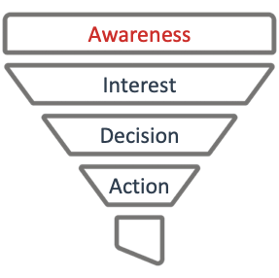
Customer Purchase Cycle
The majority of contacts are expected to be in the awareness stage of the customer purchase cycle.
The campaign content is designed to engage contacts in the awareness stage of the purchase cycle and nurture them through the consideration process to purchase.
The 8x8 UCaaS campaign assets may be deployed in a sequential manner in order to move leads through the purchase cycle.
8x8 UCaaS Business Continuity Campaign

Slide 8
Target Audience
Business Segments, Personas & Primary Needs
Enterprise and Upper Mid-Market
More likely to see customer experience as a strategic differentiator and business driver.
Likely to be dealing with more significant levels of IT and business complexity, including legacy systems and multiple point solutions.
VP, Customer Support
Enhance rep productivity and effectiveness as an easy-to-use, integrated solution with real-time dashboards, insights and coaching.
Improve management via centralized admin and analytics.
Reduce time to implement changes and reach to ongoing customer needs.
IT Director and Risk Manager
Secure, reliable, high-quality communications that are easy to use, administer and maintain.
8x8 UCaaS Business Continuity Campaign

Slide 9
8x8 UCaaS Business Continuity Campaign
Content & Promotional Assets
Content Assets
[Case Study] Live Oak Bank Delivers Exceptional Service Even During a Natural Disaster
[Solution Overview] Maintain Business Readiness with 8x8
[Checklist] Maintain Communications Readiness
Promotional Assets
[Social Cards] 3 versions of social cards to be used on partner social media channels
[Email] 3 versions of HTML emails with email copy/banners included
[Landing Page] 3 versions of HTML landing pages with iframe code
8x8 UCaaS Business Continuity Campaign

Slide 10
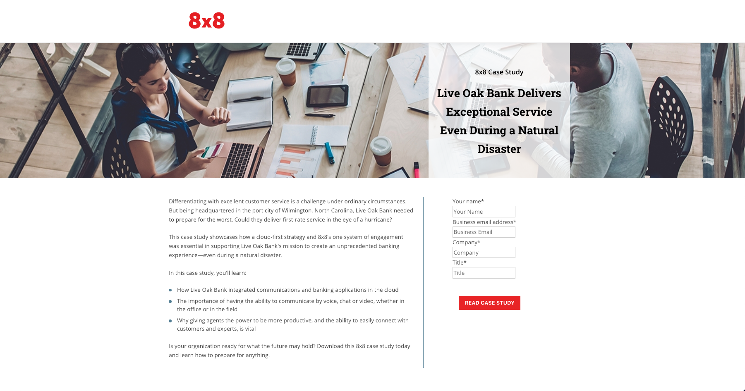
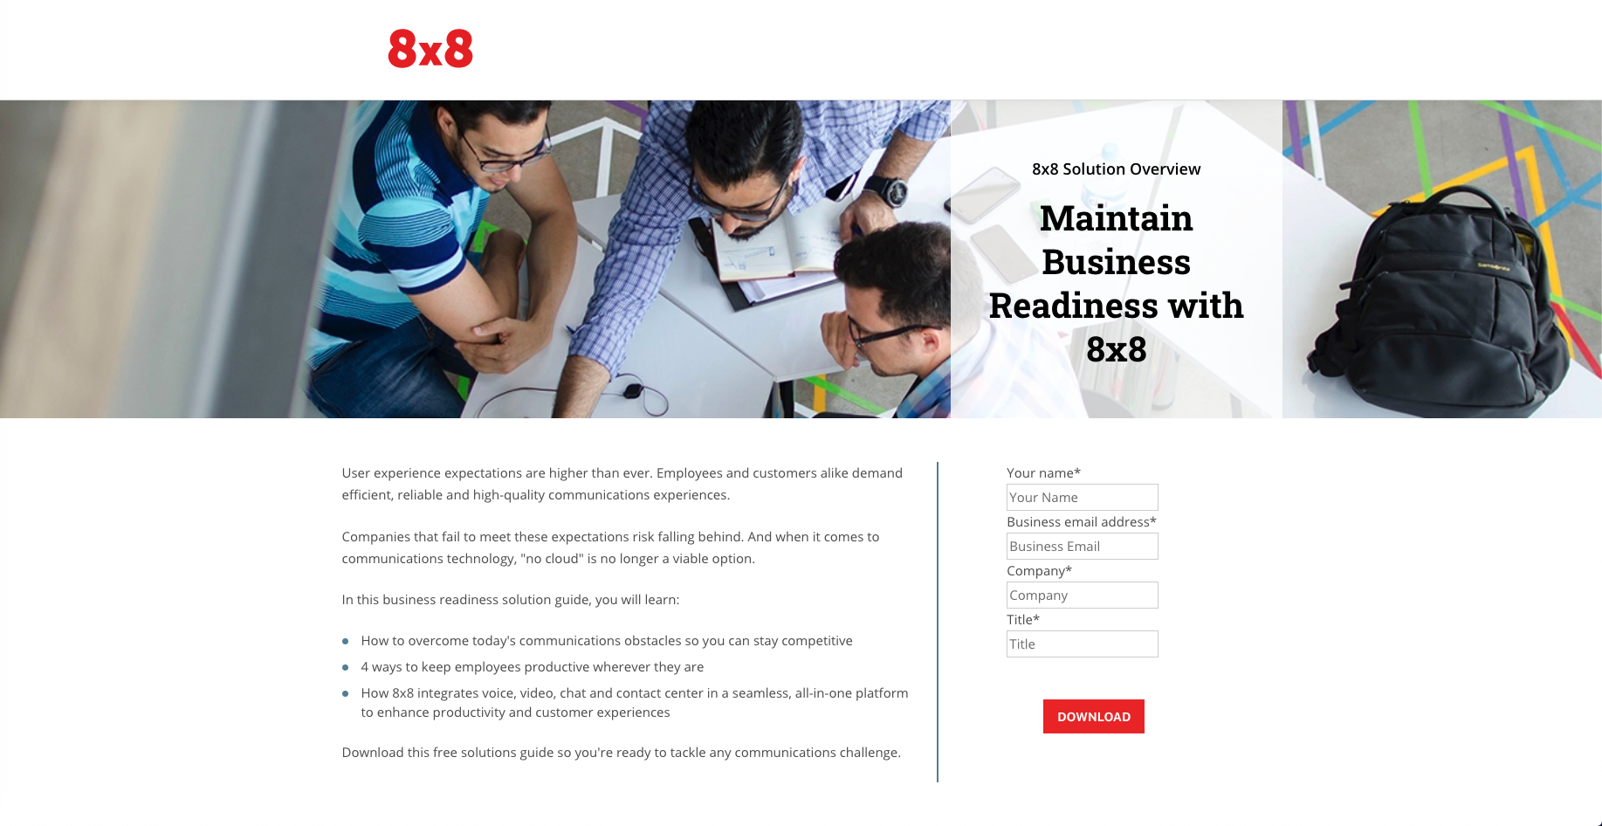
UCaaS Business Continuity Campaign
Channel Content & User Flow
Email
Touch
2
Email
Touch
3
Email
Touch
4
Email
Touch
1
Checklist
Case Study
Solution Overview
TBD
Landing page examples with data capture forms

Slide 11
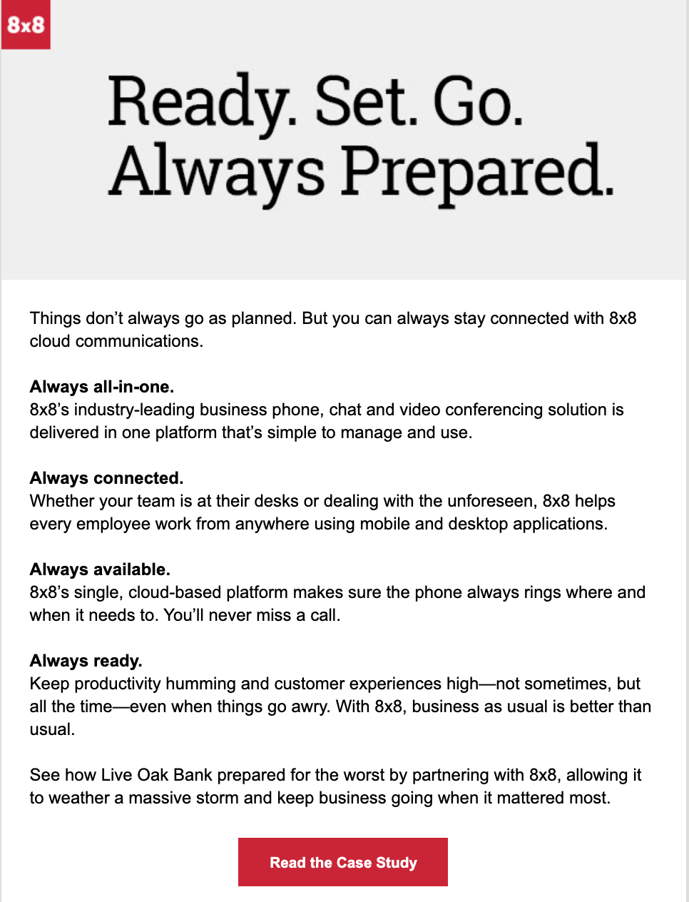
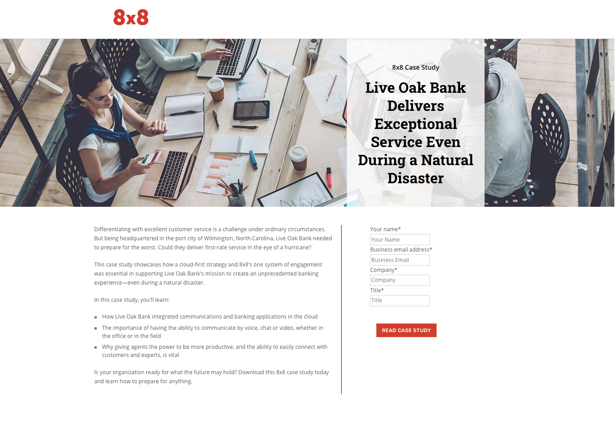
Email - Touch 1 - Live Oak Case Study
8x8 UCaaS Business Continuity Campaign

Slide 12
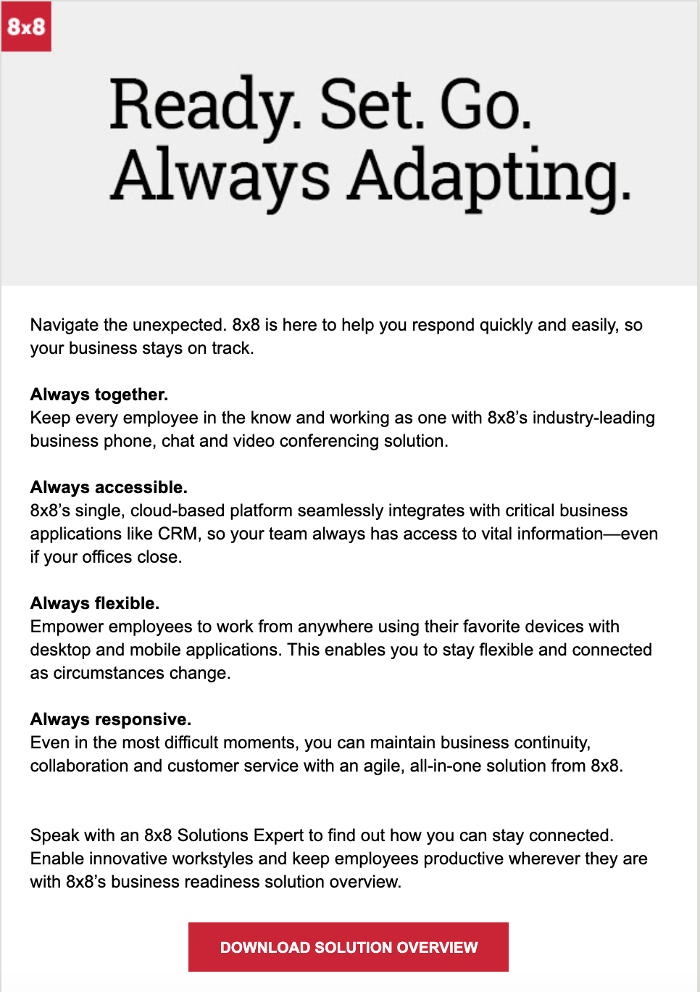
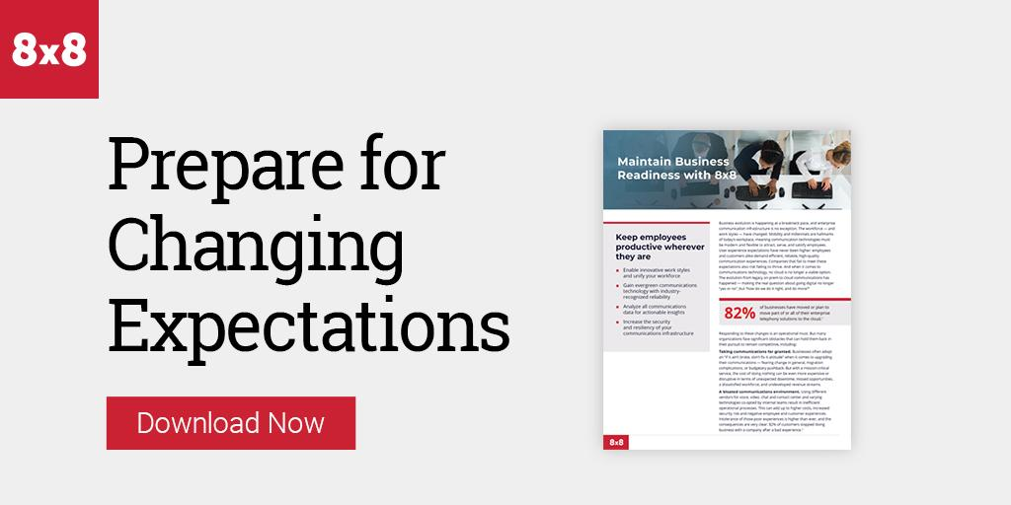
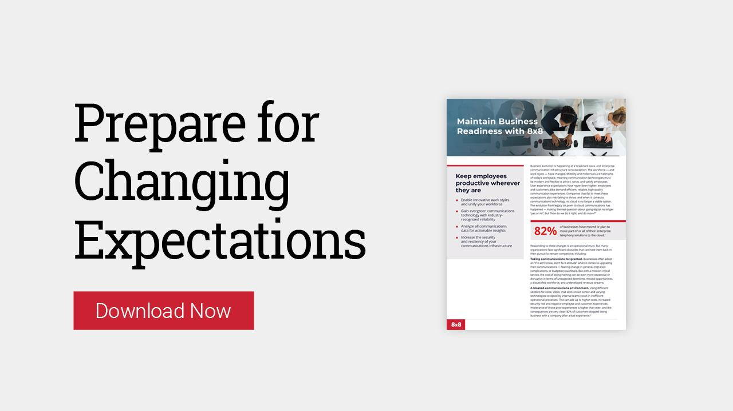
Email - Touch 2 - Solution Overview
8x8 UCaaS Business Continuity Campaign

Slide 13
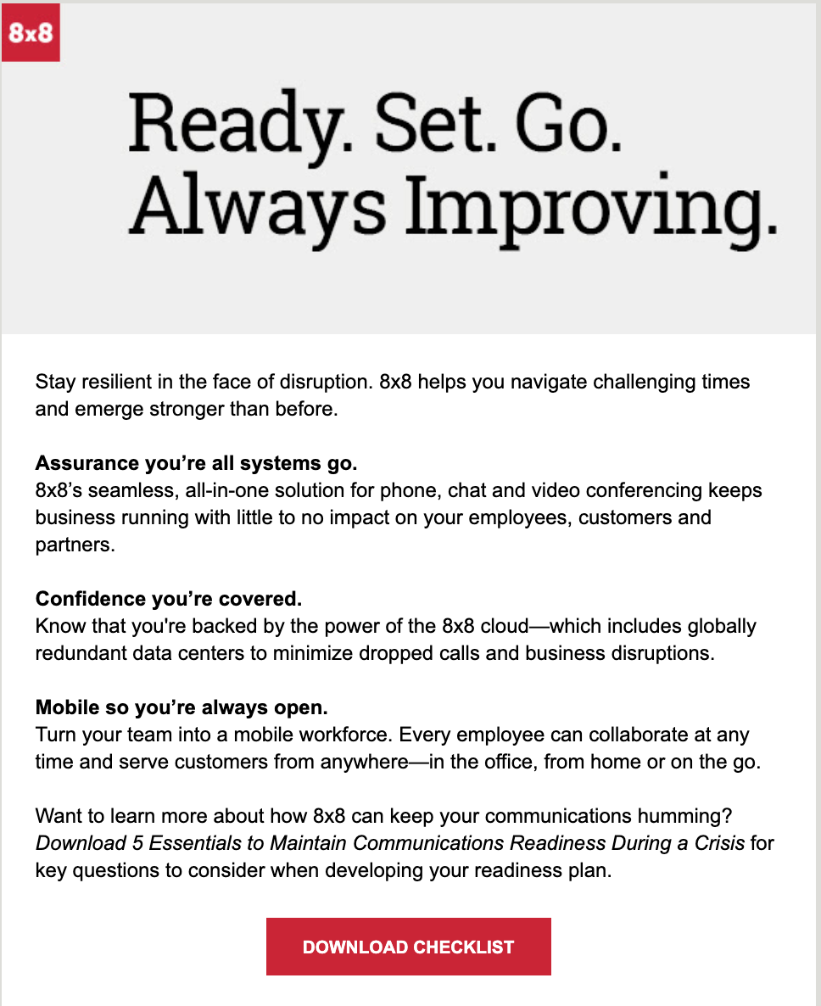
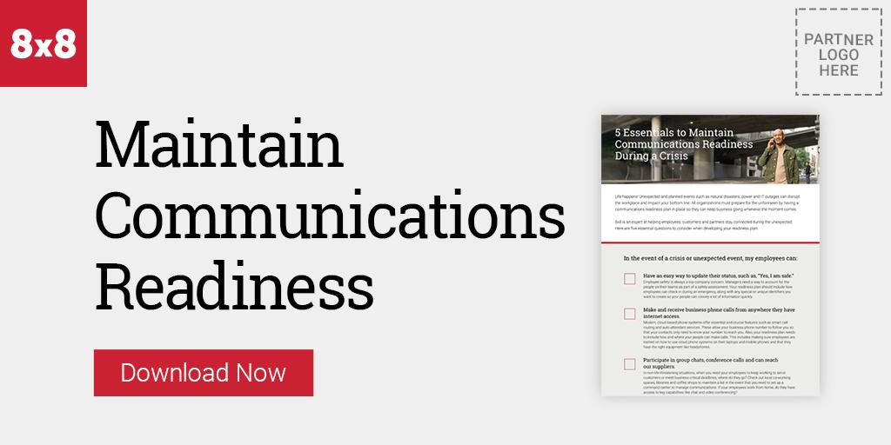
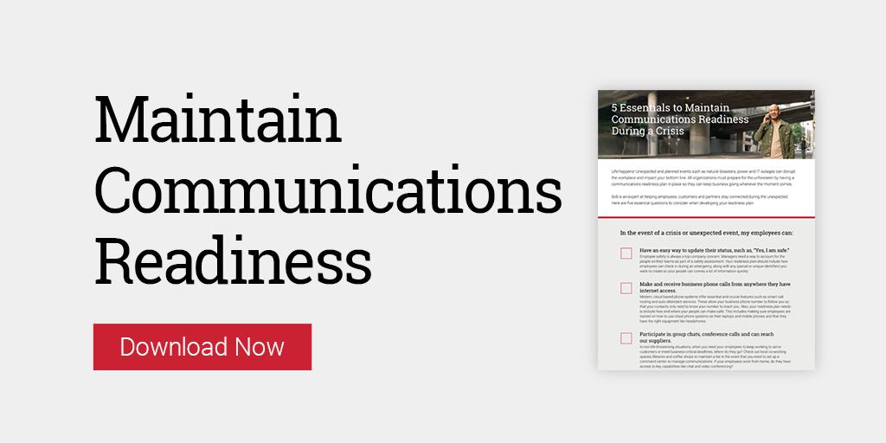
Email - Touch 3 - Readiness Checklist
8x8 UCaaS Business Continuity Campaign

Slide 14
8x8 UCaaS Business Continuity Campaign
Campaign Creative
8x8 UCaaS Business Continuity Campaign

Slide 15
Creative Assets - Touch 1 - Live Oak Case Study
8x8 UCaaS Business Continuity Campaign

Slide 16
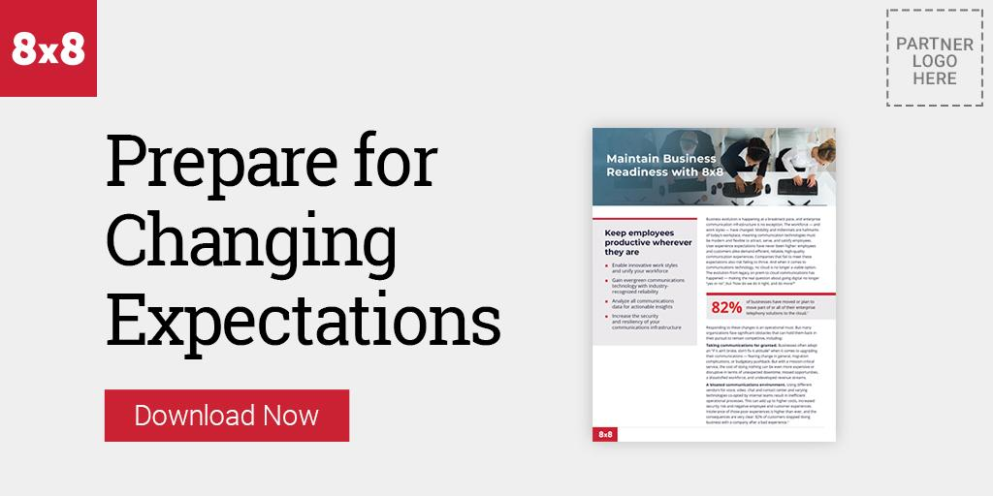
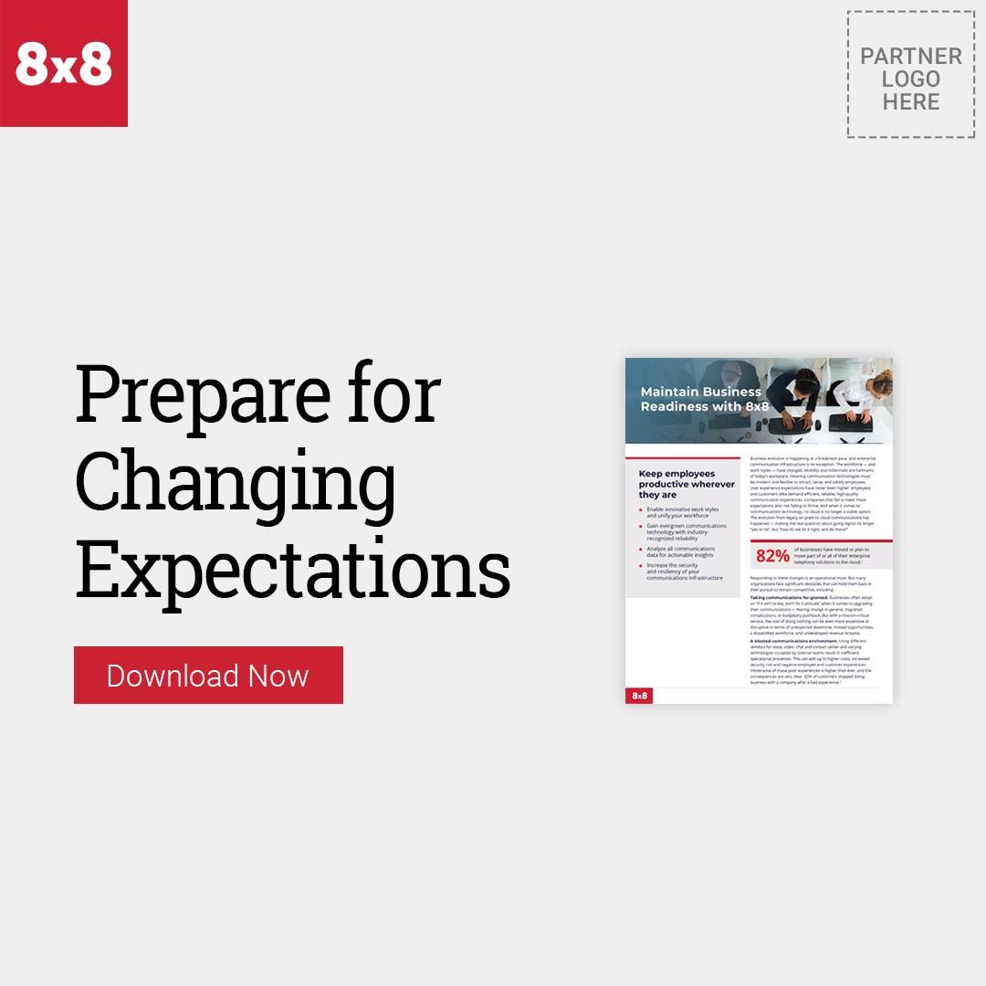
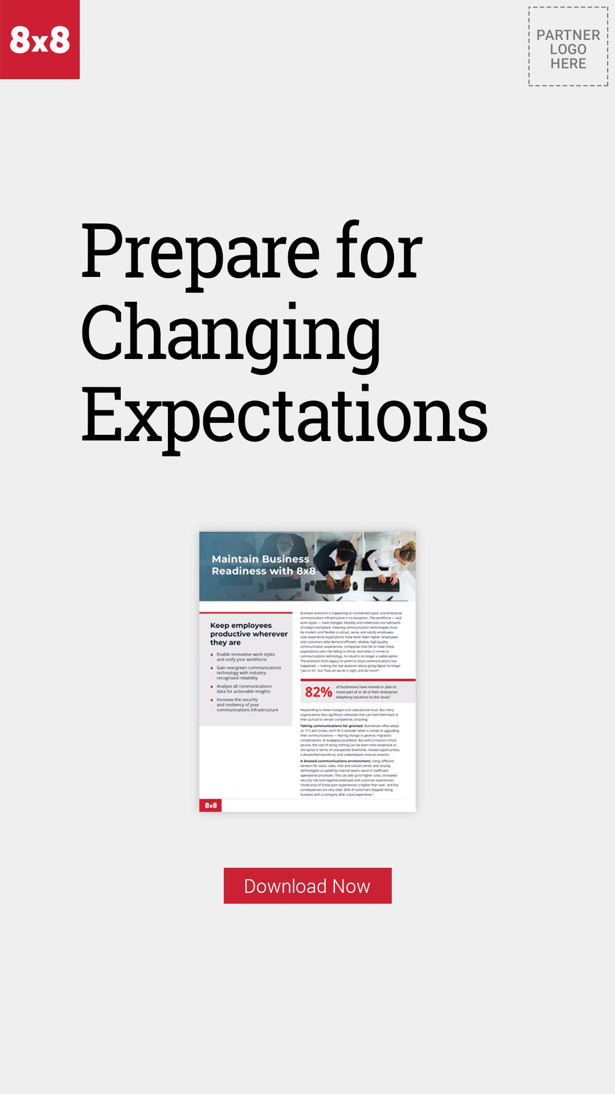
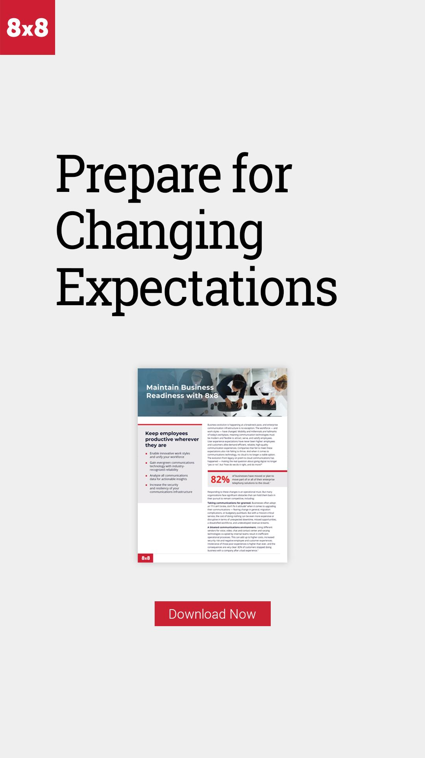
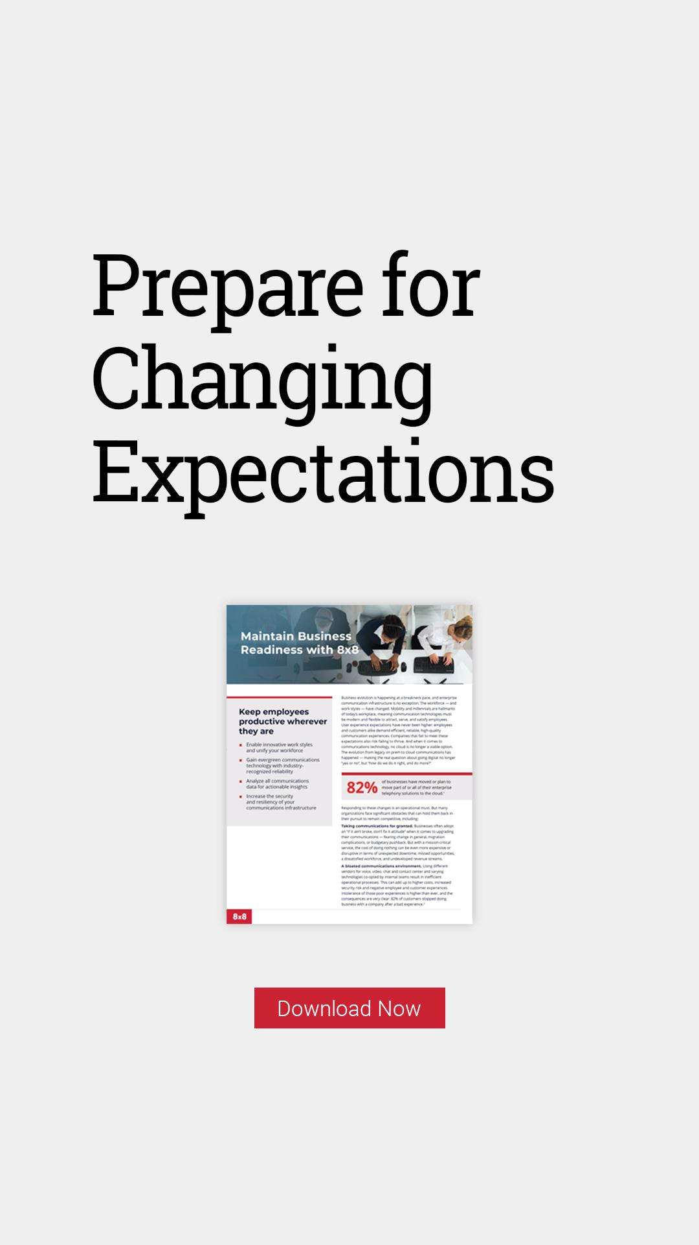
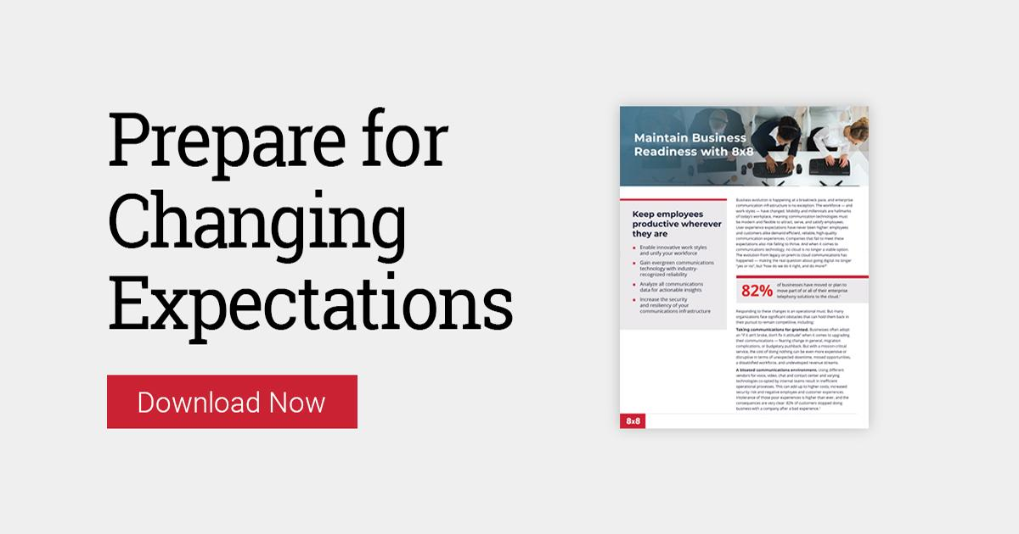
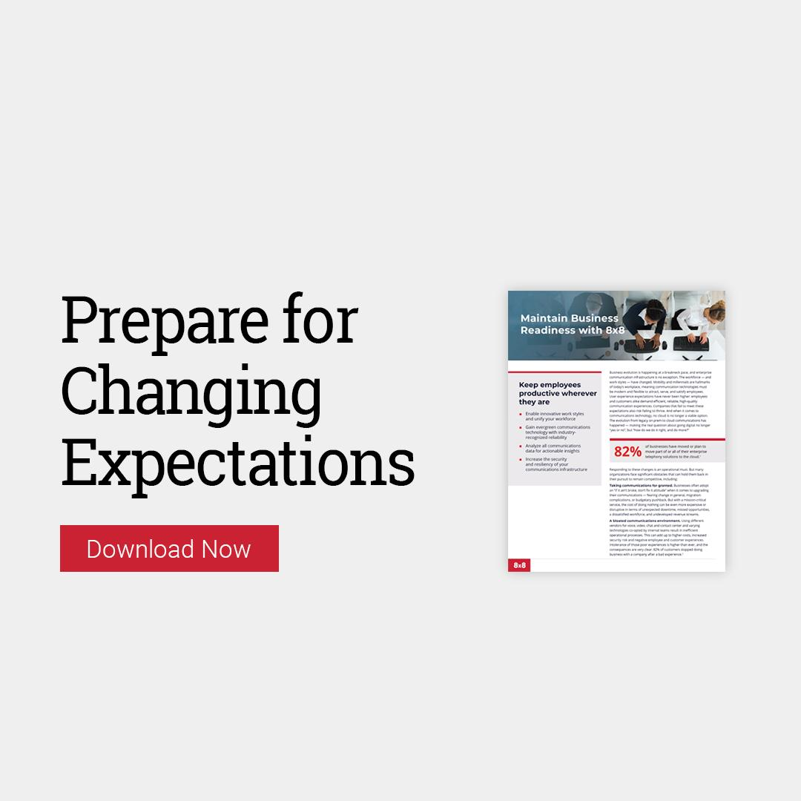
Creative Assets - Touch 2 - Maintain Business Readiness
8x8 UCaaS Business Continuity Campaign

Slide 17
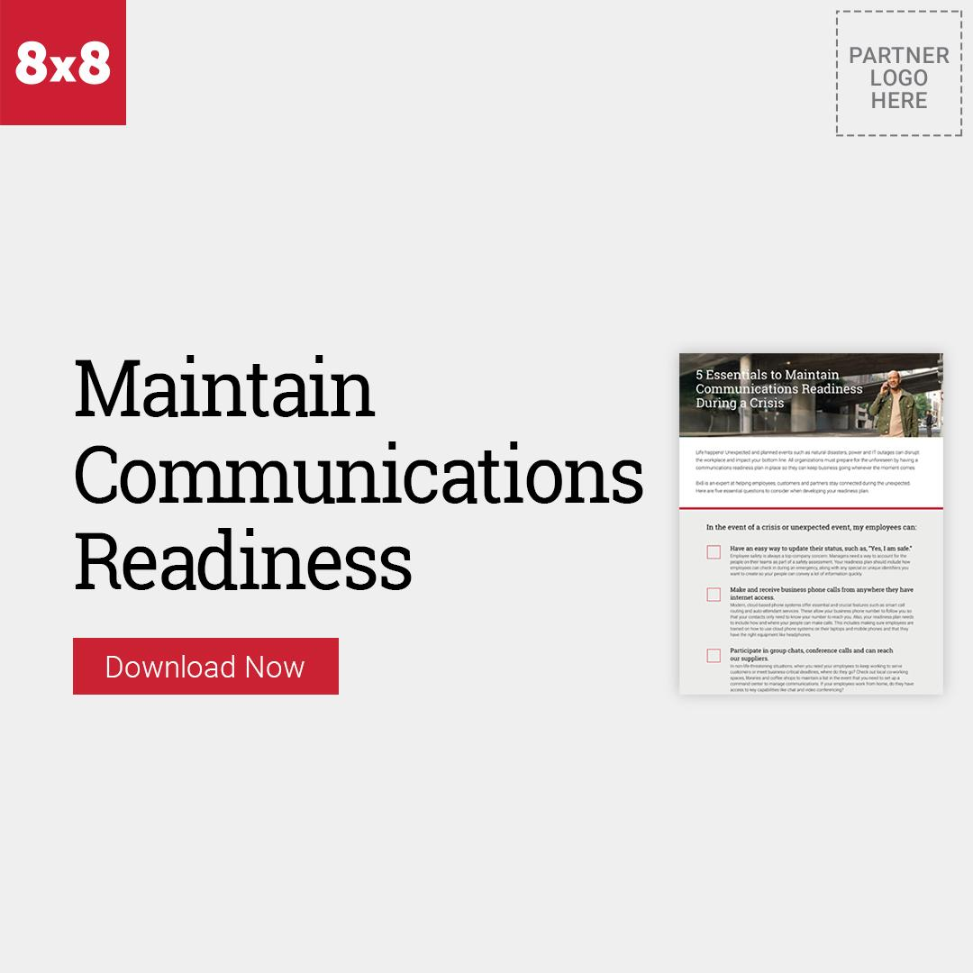
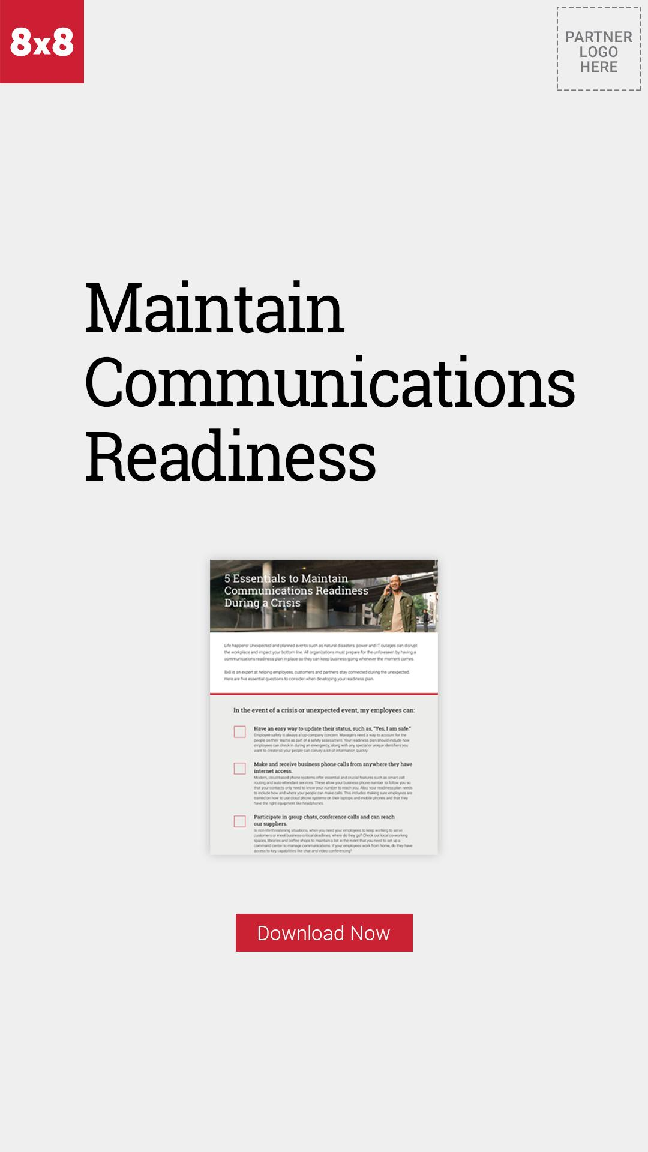
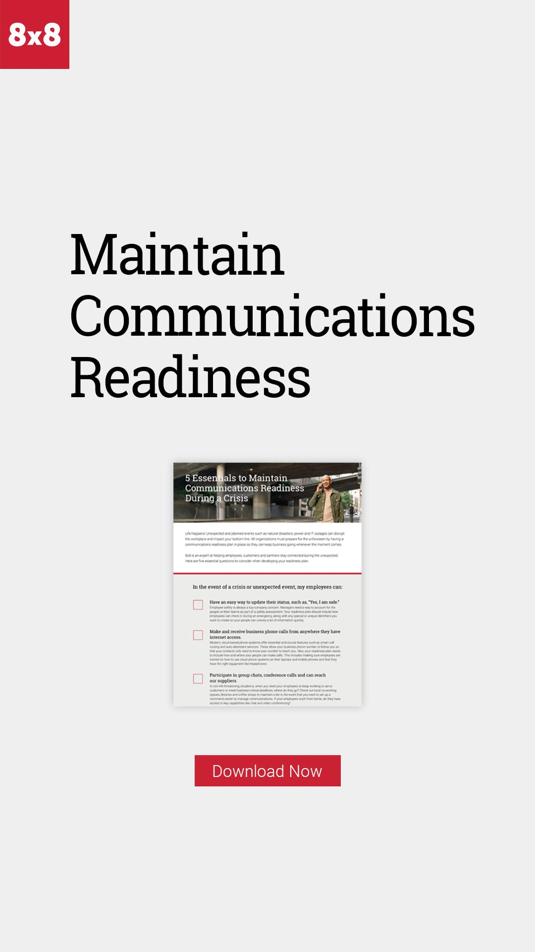
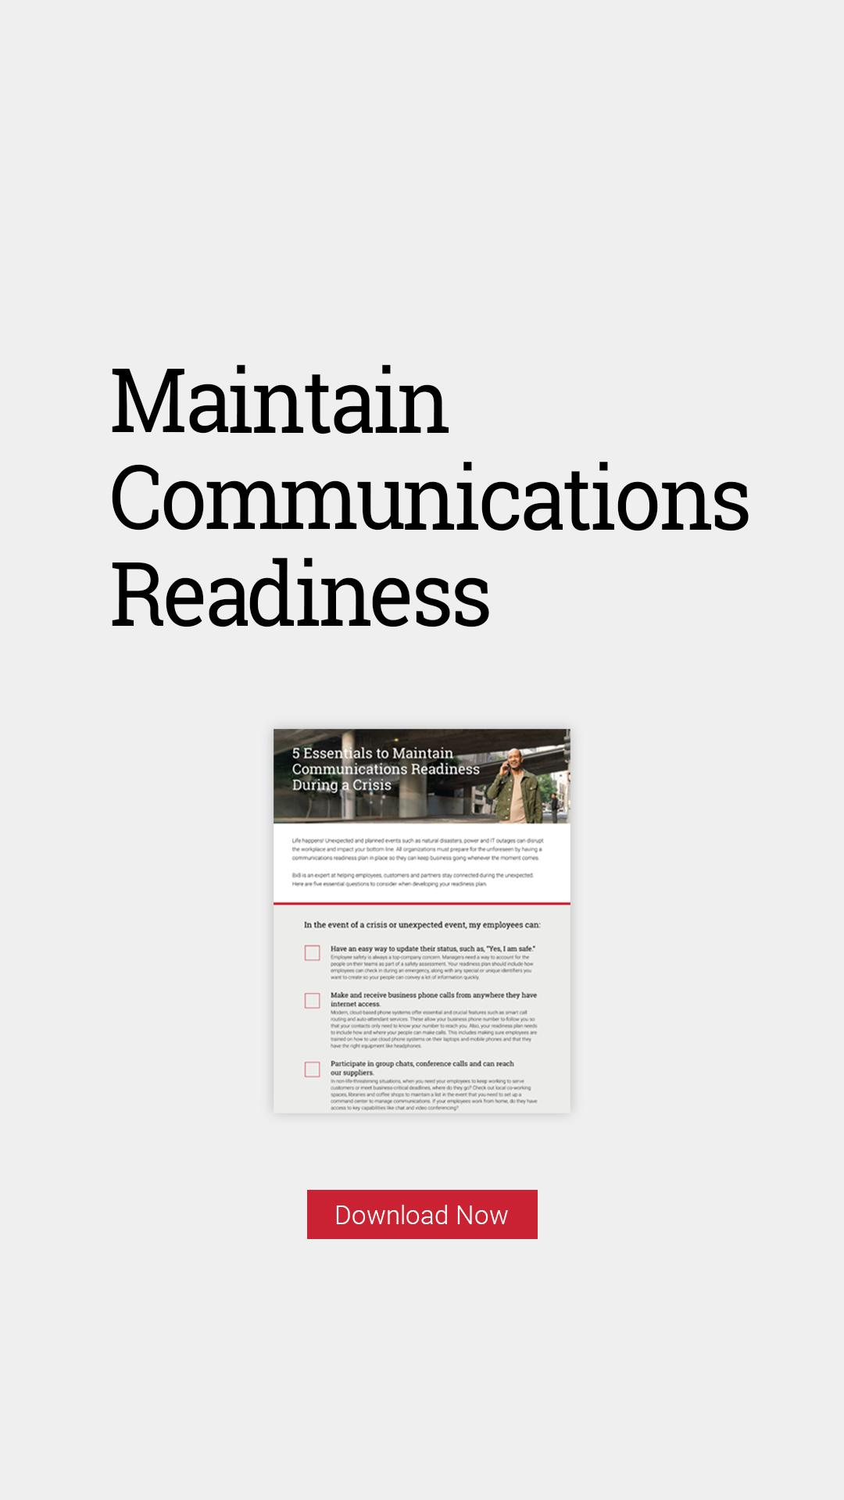
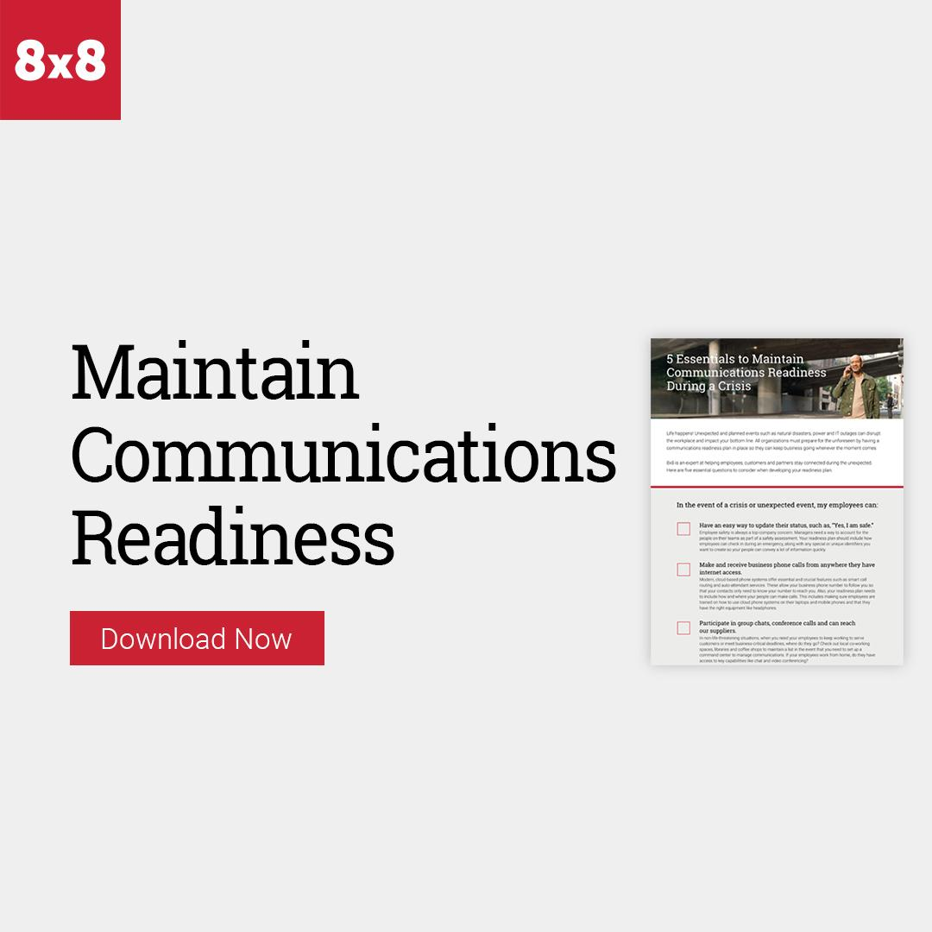
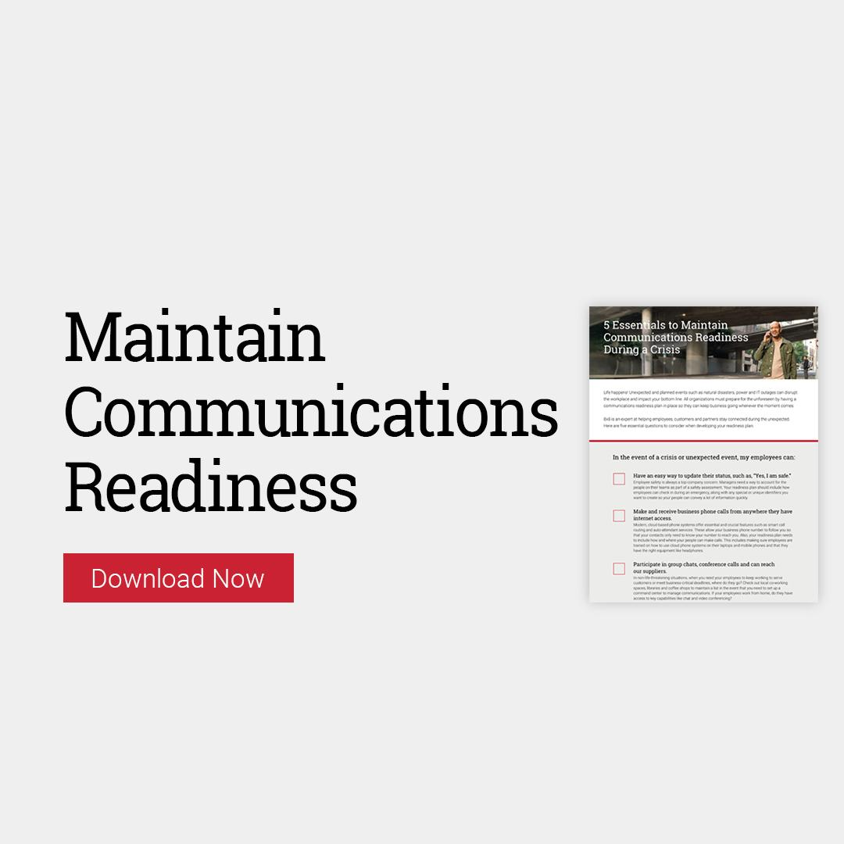
Creative Assets - Touch 3 - Readiness Checklist
8x8 UCaaS Business Continuity Campaign

Slide 18
8x8 UCaaS Call Script
Use this call script as a discussion framework when following up on leads.
1. Our Goal (What’s our goal in making contact?) | Call those contacts who clicked through to download/view the 8x8 UCaaS Business Continuity Campaign in order to confirm awareness and level of interest. Set a first-time appointment if contact is qualified and interested in learning more. | 4. Handling Objections (What barriers are there to prevent moving the opportunity forward? Potential objections can we anticipate?) | Don’t remember receiving the emails. Didn’t read or view the downloaded materials. No time to talk right now. We don’t need anything. We’re all set. Or, we’re not ready to make a change. We just purchased. We aren’t taking on any new providers / vendors at this time. Just send me some information. I’m not the right contact. (Ask who the right contact is and request to be transferred.)
2. Frame (How are we going to frame the meeting to gain the client’s agreement?) | Inquire as to what they thought, questions they have and additional information they might find of value. Qualify interest in scheduling a meeting to talk further.
3. Discovery Questions (What questions do we need to ask to get the information we require based on where we are in the sales process and the prospect’s point in the Client Buying Process?) | What triggered your interest in downloading/viewing the material? How has it influenced your view of using the 8x8 UCaaS solution? How well is your current communications solution meeting your needs? How easy is it for your customers to reach someone who can address their questions and concerns? What’s the customer’s experience when their query requires additional assistance from other employees or departments? Does your IT team spend too much time maintaining your current solution? What is your company’s experience of using analytics to optimize the customer experience and agents? Would you be interested in learning more about how a cloud-based platform could transform your business? Other pain points or questions you typically ask to qualify a new prospect. Suggest setting an appointment to discuss these items in more detail. | 5. Recommend (What recommendations can we anticipate? What additional information is needed to fill a knowledge gap and gain support?) | Make recommendations about how 8x8 Cloud Communications is the most reliable, secure cloud platform. If qualified, recommend a meeting to: Continue the discussion Discuss their collaboration challenges and needs If you have helped other clients with similar challenges, share the situation and results to generate further interest in talking with you.
 |  | 6. Client’s Next Step (What commitments or actions can we get?) | Agree to a specific meeting day and time or ask to refer you to the decision maker if they are not the correct person to meet with.
8x8 Contact Center Campaign

Slide 19
8x8 UCaaS Business Continuity Campaign
Implementation Guidelines
8x8 UCaaS Business Continuity Campaign

Slide 20
8x8 UCaaS Business Continuity
Campaign Engagement
Monitoring Engagement | Scoring Engagement | Sales Calls & Follow Up
Campaign should be run on a marketing platform that can track key actions, such as email opens, clicks and downloads. Landing pages are designed to capture key contact information prior to asset download. Contact information submitted in the form will be sent to you via email. | Track which contacts are opening the emails and downloading content. Recommended lead scoring: 1 point for opens. 2 points for clicks on email CTAs. 5 points for each download. Calculate the cumulative scores for each prospect and prioritize for sales follow-up. | Throughout the campaign, prospects may respond to one or more emails with an invitation to contact them or to request additional info. The sales teams should follow up with those prospects via email or phone. Unsolicited follow-up calls should be avoided until after lead scores have been finalized.
8x8 UCaaS Business Continuity Campaign

Slide 21
8x8 UCaaS Business Continuity
Campaign Planner
Pre-Launch | Launch Week | Week 2 | Week 3 | Post-Launch
Upload the list of contacts for this campaign to your email service. Create and test each of the 3 landing pages. Compose Email 1. Test the email format and hyperlink. | Send Email 1. Recommend sending early AM, Tues-Thurs. Monitor email opens, clicks and downloads. Compose Email 2. Test the email format and hyperlink. Launch banner ads and social posts. | Send Email 2. Recommend sending early AM, Tues-Thurs. Monitor email opens, clicks and downloads. Compose Email 3. Test the email format & hyperlink. | Send Email 3. Recommend sending early AM, Tues-Thurs. Monitor email opens, clicks and downloads. | Tally the engagement (opens, clicks and downloads) across all 3 emails. Call the most engaged contacts to secure an appointment. The general rule is to call all contacts who have 2 or more downloads, 2 or more opens and at least 1 download.
8x8 UCaaS Business Continuity Campaign

Slide 22
8x8 UCaaS Business Continuity Campaign
HTML Email Instructions
General Instructions
All three (3) emails in this campaign are graphic HTML emails designed to capture the reader’s attention. Other than the limited edits identified below, no changes should be made to the design layout, images or the HTML code.
Edit #1 - Co-branding and logo placement
Each email has a block for you to add your company logo and contact information. The layout for this block should remain consistent across all emails with the logo on the right side.
Edit #2 – Customizing the embedded hyperlinks
The image block for your logo has a placeholder for you to embed a link back to your home page. Additionally, the CTA (Call-to-Action) button links in the emails must be replaced with a link to the landing page.
Edit #3 – Update footer
Replace email footer at the very bottom of HTML and replace with your company information.
Note that the above changes should be performed by someone skilled in creating and editing HTML emails so as not to break any of the surrounding code. Each email has comments surrounding the lines to be edited. Once the edits have been completed and successfully tested, these comments should be deleted to ensure they don’t impact your deliverability to the inbox.
8x8 UCaaS Business Continuity Campaign

Slide 23
8x8 UCaaS Business Continuity Campaign
Landing Page Implementation Instructions
The landing pages are designed to be integrated into your website so your branding is preserved. It is also designed to alert you via email each time a visitor downloads one of the assets. You will need to provide your webmaster with the email address where you want these alerts to be delivered.
Your webmaster will need to create and test these landing pages before the emails are scheduled to be sent out. There are 2 indicators the test was successful:
The entire landing page is displayed properly with no scroll bars.
The alert email arrives in your designated email box shortly after you’ve downloaded the asset.
8x8 UCaaS Business Continuity Campaign

Slide 24
8x8 UCaaS Business Continuity Campaign
Webmaster Instructions
The HTML code for the iframe landing pages can be found on the next three (3) slides. The items displayed in red will need to be edited:
SIZE
The iframe will display properly without scrollbars when the width is set to 1200 and the height is set to 1750. The form is responsive so you can set the iframe to a narrower width if necessary.
At narrower widths, the height may need to be changed to 2300 to prevent scrollbars from reappearing.
EMAIL PARAM
The email address should be updated to the address provided by your sales team.
Important Note: The email address must be formatted as plain text (yourmailbox@mailserverdomain.com). The email server cannot send notices to email addresses that have been encoded. Please conduct several tests to ensure you are successfully receiving the notification emails each time the web form is completed.
8x8 UCaaS Business Continuity Campaign

Slide 25
iFrame Code: Landing Page 1
Live Oak Bank Case Study
Landing Page 1 – Live Oak Bank Delivers Exceptional Service Even During a Natural Disaster
The section displayed in red will need to be edited to the address you would like to receive notifications.
<iframe src="https://www.8x8.com/8/work-remotely-v1-ccaas-live-oak-case-study?email=name@domain.com" name="frame1" scrolling="yes" frameborder="no" align="center" width="1200" height="1750" ></iframe>
8x8 UCaaS Business Continuity Campaign

Slide 26
iFrame Code: Landing Page 2
Maintain Business Readiness
Landing Page 2 – Maintain Business Readiness
The section displayed in red will need to be edited to the address you would like to receive notifications.
<iframe src="https://www.8x8.com/8/work-remotely-v1-maintain-business-readiness-with-8x8?email=name@domain.com" name="frame1" scrolling="yes" frameborder="no" align="center" width="1200" height="1750" ></iframe>
8x8 UCaaS Business Continuity Campaign

Slide 27
iFrame Code: Landing Page 3
Maintain Communications Readiness
Landing Page 3 – Maintain Communications Readiness
The section displayed in red will need to be edited to the address you would like to receive notifications.
<iframe src="https://www.8x8.com/8/work-remotely-v1-communications-readiness-emergency-checklist?email=name@domain.com" name="frame1" scrolling="yes" frameborder="no" align="center" width="1200" height="1750" ></iframe>
8x8 UCaaS Business Continuity Campaign

Slide 28
Thank you.
8x8 UCaaS Business Continuity Campaign

