Slide 1
8x8 Voice for Microsoft Teams
Connect from Everywhere: Essentials Campaign
Partner Implementation Guide
Package #2 (eBooks 5-8)

Slide 2
Welcome to the Channel Partner Guidelines for the 8x8 Voice for Microsoft Teams Essentials Campaign package #2. This document provides you with strategic guidance and marketing assets to execute touches 5-8 of the campaign in a turnkey manner.
Contents:
Campaign overview
Campaign creative and content
Emails
Social banners
iFrame Landing page
Outreach sequence
Implementation guidelines
8x8 Voice for Microsoft Teams Essentials Campaign
‹#›

Slide 3
Campaign Overview

Slide 4
Connect from Everywhere:
Better Voice Communications for Microsoft Teams
The first half of 2020 was defined by the need for agility and adjustment in how we communicate. The months ahead will be defined by how we reinvent working and connecting with each other, our customers, partners, and beyond.
These essential eBook guides will provide you with valuable insights and learnings to accelerate your organization’s Microsoft Teams user experience and supercharge Teams and other apps with enterprise global voice communications capabilities.
As easy as, one, two, Teams.
Learning the new way to connect will be easier than unlearning the hard way.
Set it and forget it.
Supercharge Teams without a superhuman effort.
Numbers don’t lie.
The proof is in the productivity gains. Calculate your ROI today.
Time to get started.
Get a wrap-up of everything 8x8 Voice for Microsoft Teams has to offer.

Slide 5
Connect from Everywhere:
Campaign Objectives
Tell a strong and compelling story, using promotional messaging and content assets, that drives awareness and interest for 8x8 Voice for Microsoft Teams
Awareness
Enablement
Enable channel partners to generate leads and progress them through the funnel via channel marketing assets and a channel implementation guide/campaign playbook.
Bring on net new customers seeking a global enterprise-grade telephony solution that integrates seamlessly with Microsoft Teams
Prospects

Slide 6
8x8 Voice for Microsoft Teams Essentials Campaign
Overview
Companies don't need to settle for app-switching to bring people and apps together. In this campaign the audience will learn how to supercharge MS Teams and other apps with integrated global voice communications capabilities.
Microsoft Teams is the fastest growing enterprise collaboration application globally. Increasingly prospects that are looking for a communications solution will only consider vendors that integrate with Teams.
Teams users need an enterprise-grade telephony provider to offer PSTN calling services, and cloud providers such as 8x8 are uniquely positioned to offer this complementary capability. 8x8 is uniquely positioned to complement Microsoft Teams as its underlying communications layer while keeping Microsoft Teams at the center of the user’s collaborative experience.
8x8 Voice for Microsoft Teams Essentials Campaign

Slide 7
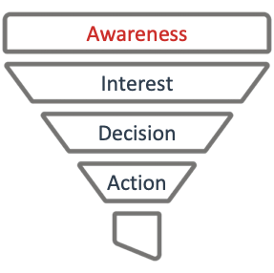
Customer Purchase Cycle
The majority of contacts are expected to be in the awareness stage of the customer purchase cycle.
The campaign content is designed to engage contacts in the awareness stage of the purchase cycle and nurture them through the consideration process to purchase.
The 8x8 Voice for Microsoft Teams campaign assets may be deployed in a sequential manner in order to move leads through the purchase cycle.
8x8 Voice for Microsoft Teams Essentials Campaign

Slide 8
Target Audience
Business Segments, Personas & Primary Needs
Enterprise and
Upper Mid-Market
R
The VP, SVP, EVP of IT and CIO
I need a single global PSTN communications solution that works for my MS Teams users as well as my non MS Teams users
I need to show a significant ROI on my communications and MS Teams investments
I want to minimize the number of vendors we have to manage
The IT Manager, Director, Sr. Director of IT
I want to minimize the number of support calls we get and keep our support and maintenance costs down
I want to have to retrain employees on how to make and receive calls in MS Teams, nor change my employee onboarding programs
I want to minimize the number of vendors I need to deal with when troubleshooting a problem
8x8 Voice for Microsoft Teams Essentials Campaign

Slide 9
8x8 Voice for Microsoft Teams
Content & Promotional Assets
Content Assets
[eBook] As easy as one, two, Teams.
[eBook] Set it and forget it.
[eBook] Numbers don’t lie.
[eBook] Time to get started.
Promotional Assets
[Social Cards] 4 versions of social cards to be used on partner social media channels in various sizes
[Email] 4 versions of HTML emails with email copy/banners included
[Landing Page] 4 versions of HTML landing pages with iframe code
8x8 Voice for Microsoft Teams Essentials Campaign

Slide 10
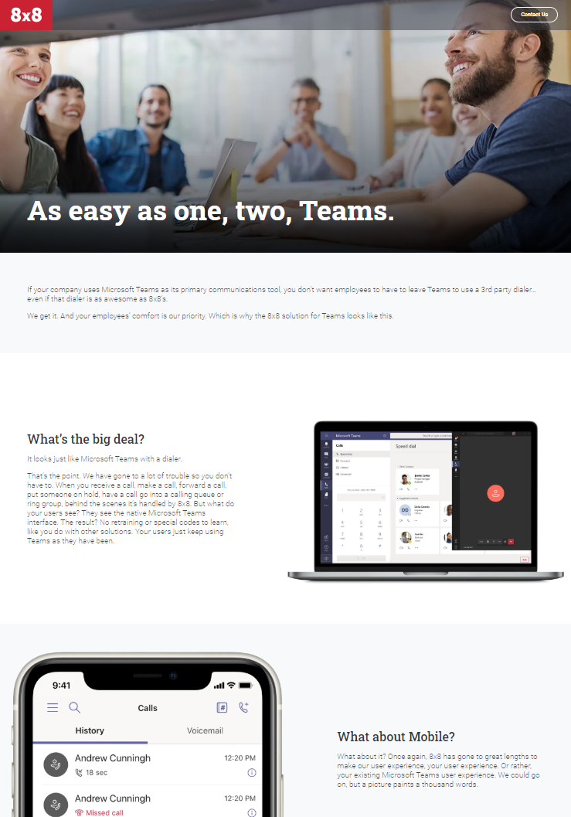
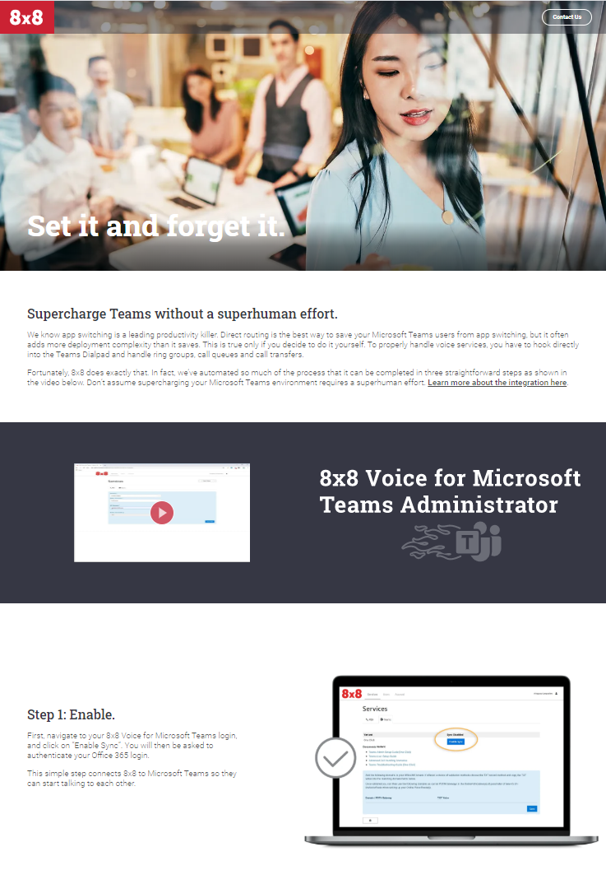
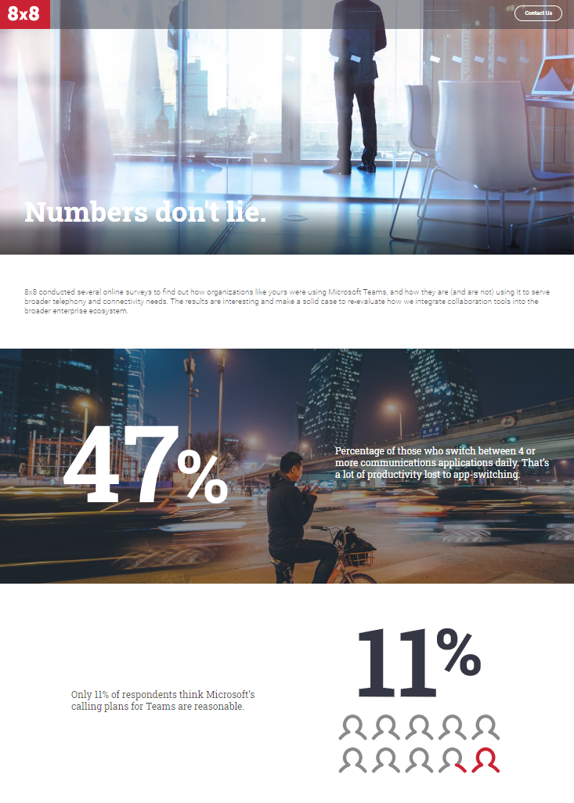
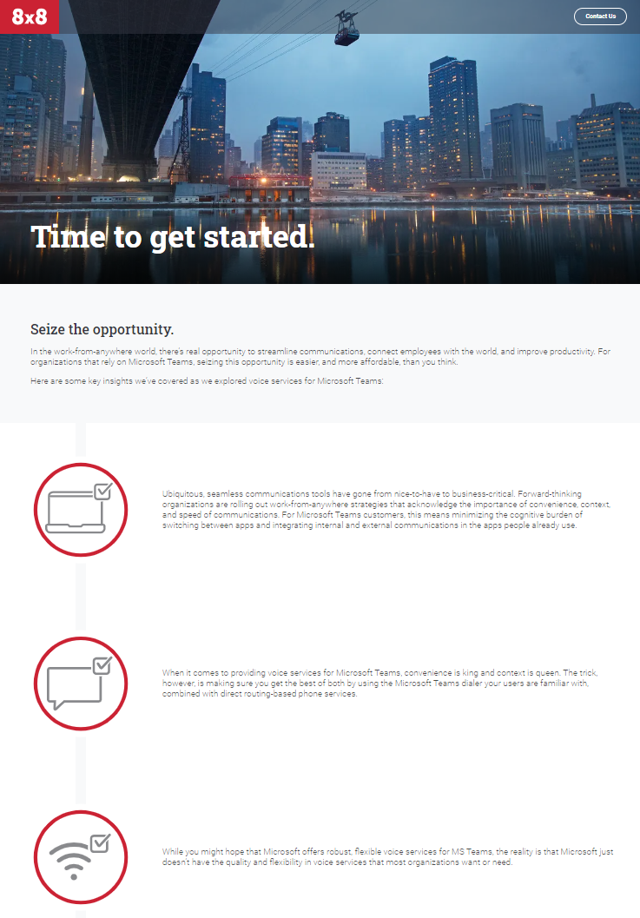
Channel Content & User Flow
Email
Touch
5
Email
Touch
6
Email
Touch
7
Email
Touch
8
[eBook]
As easy as one, two, Teams.
[eBook]
Set it and forget it.
[eBook]
Numbers don’t lie.
[eBook]
Time to get started.

Slide 11
Creative

Slide 12
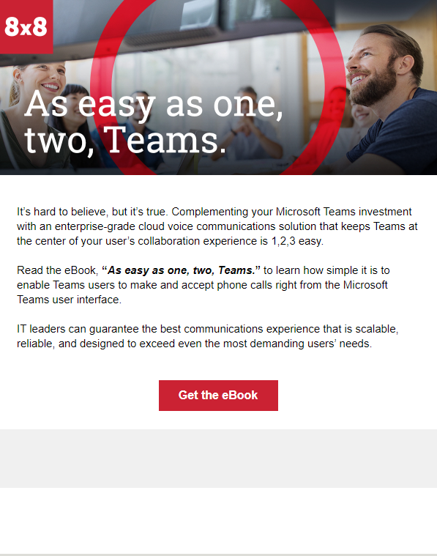
Email - Touch 5 | As easy as one, two, Teams.
Social Graphic
HTML Email
Landing Page

Slide 13
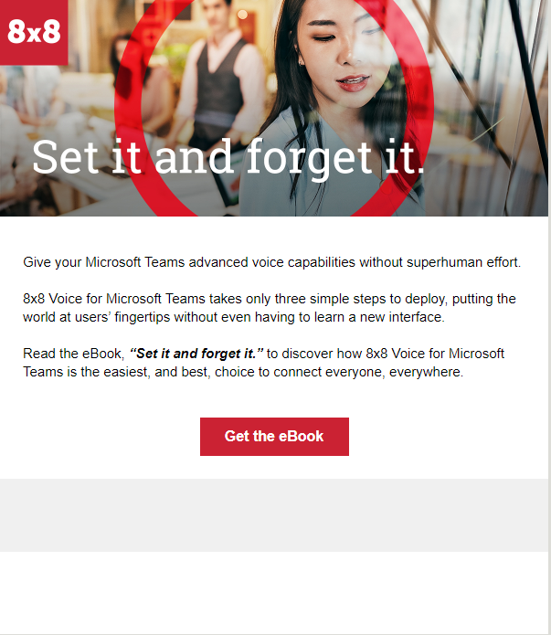
Email - Touch 6 | Set it and forget it.
Social Graphic
HTML Email
Landing Page
8x8 Voice for Microsoft Teams Essentials Campaign

Slide 14
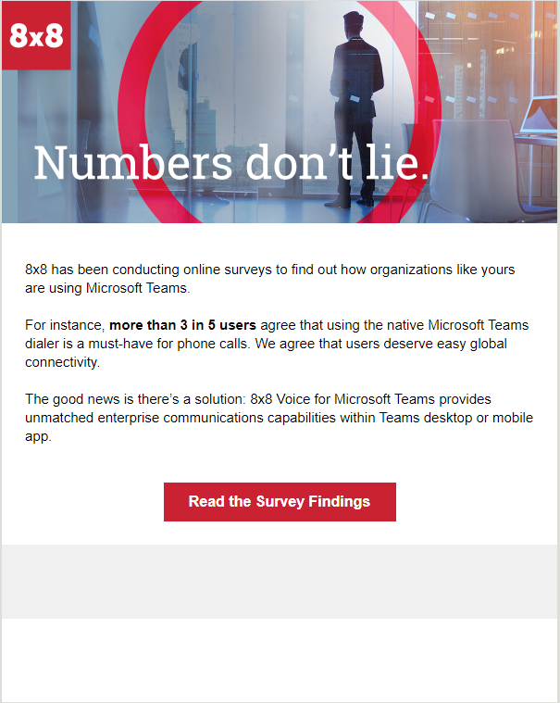
Email - Touch 7 | Numbers don’t lie.
Social Graphic
HTML Email
Landing Page
8x8 Voice for Microsoft Teams Essentials Campaign

Slide 15
Email - Touch 8 | Time to get started.
Social Graphic
HTML Email
Landing Page
8x8 Voice for Microsoft Teams Essentials Campaign

Slide 16
Partner Co-Branding Guidelines

Slide 17
Co-Branded Banner Ads
Logo placement: The 8x8 logo in co-branded banners should have equal or greater weighting to the partner logo.
The specifics of logo placement will vary by the banner aspect ratio.
Partner Logo Placement Area

Slide 18
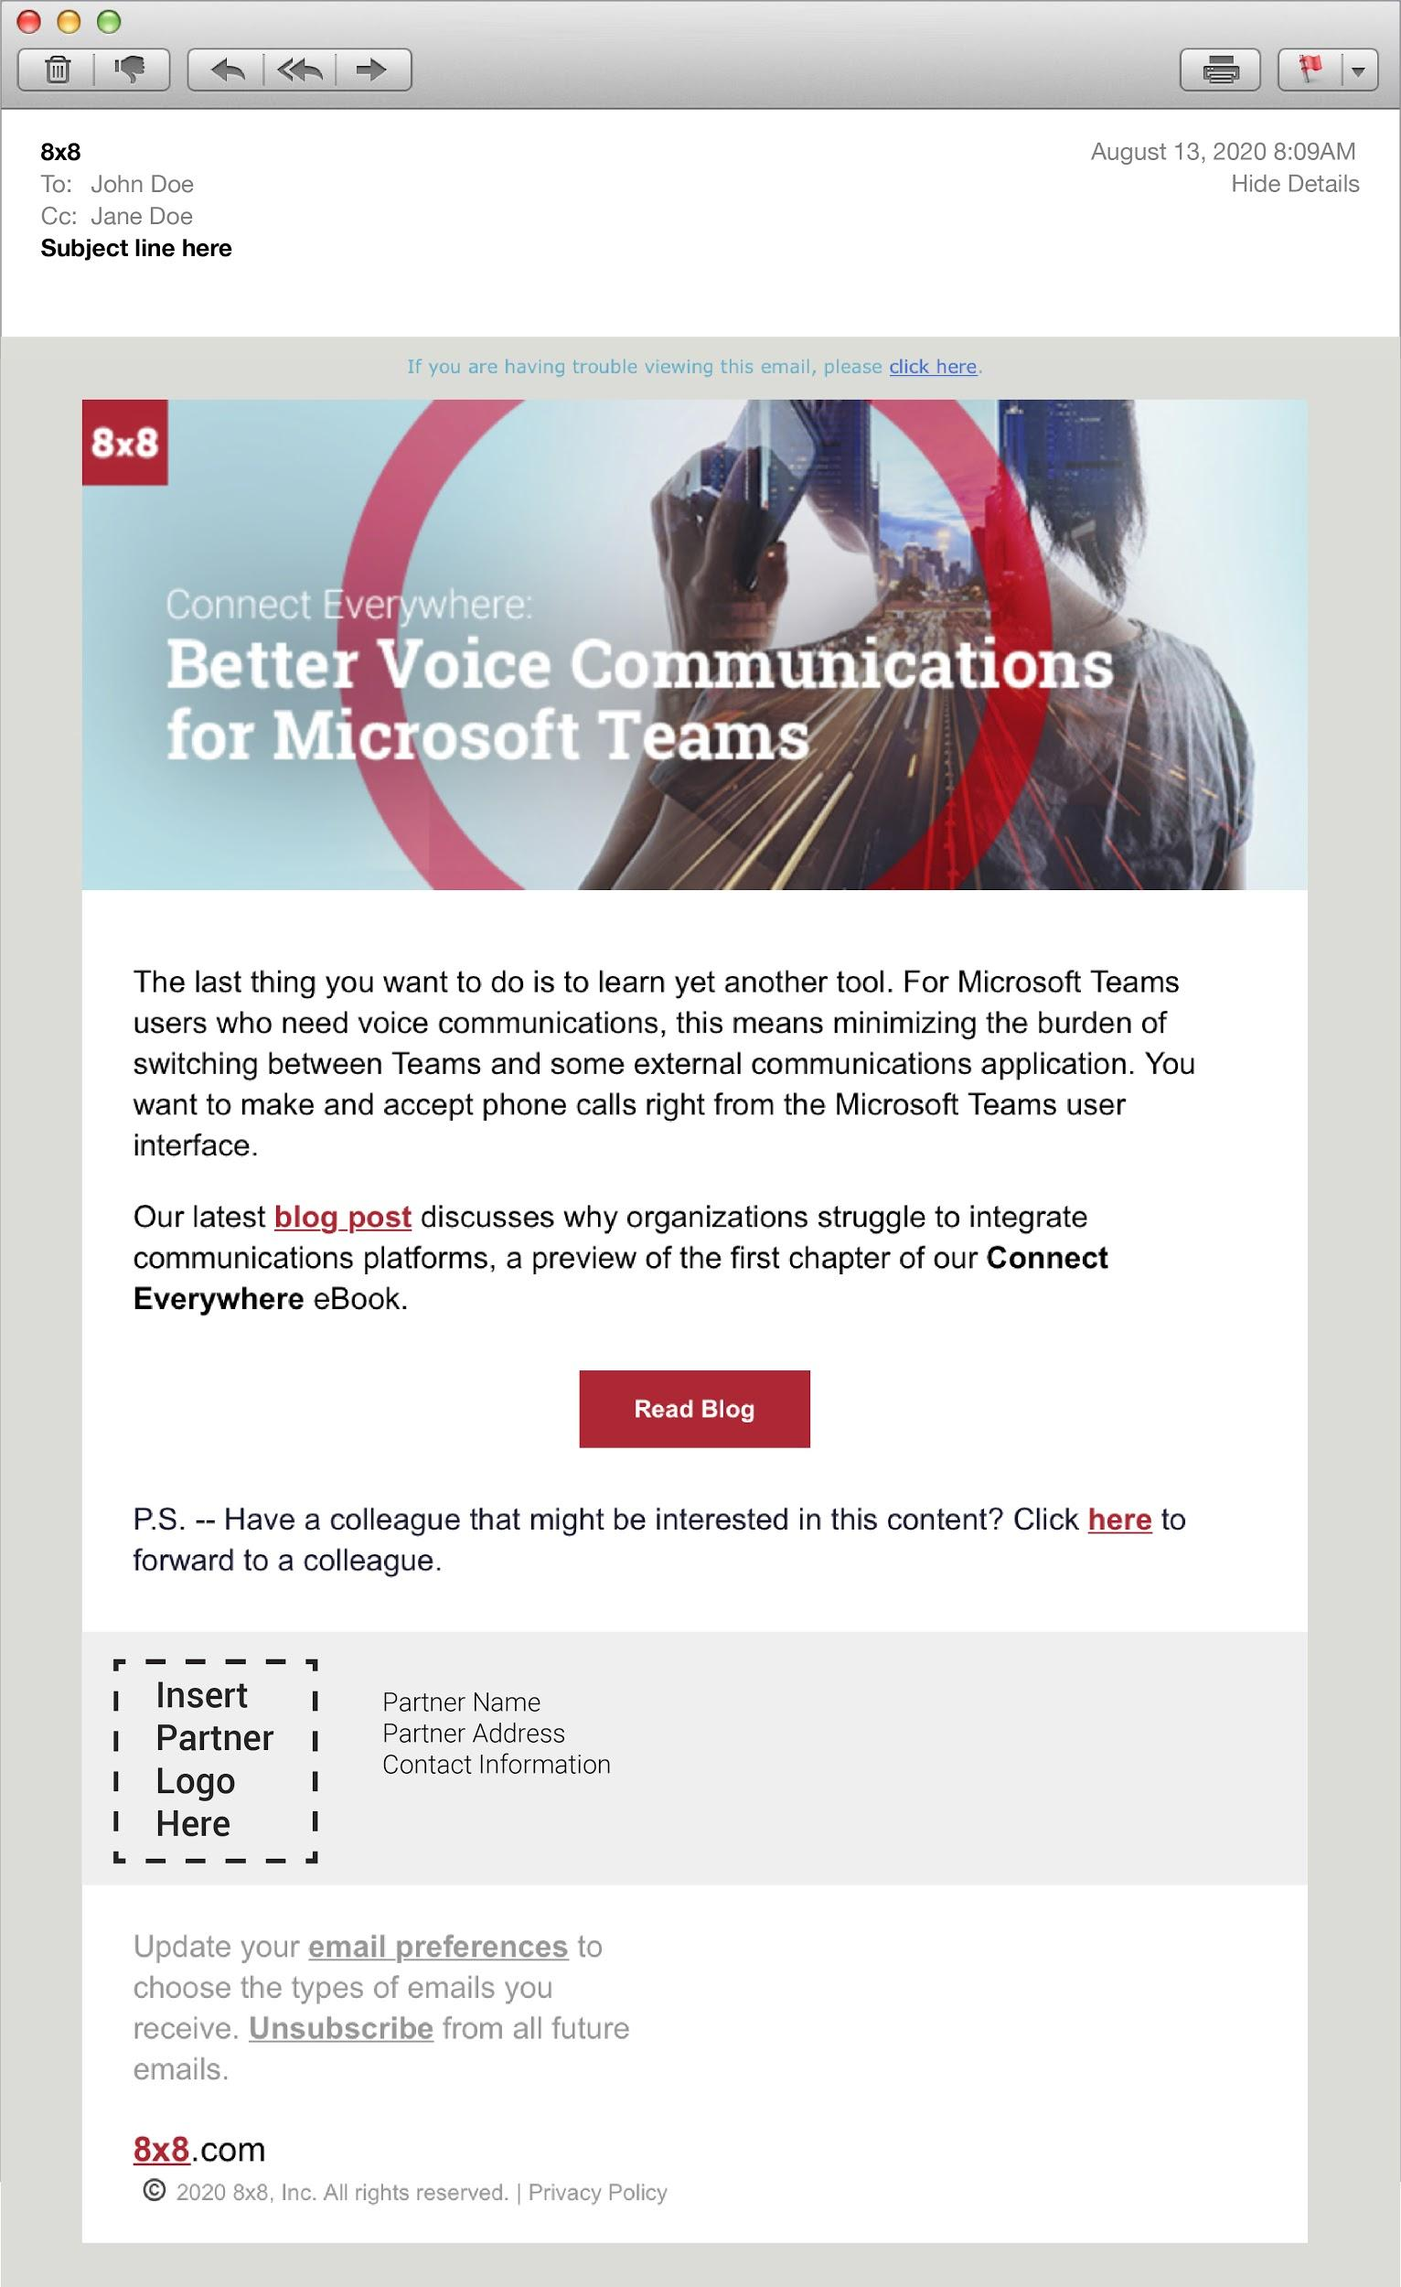
Co-Branded Emails
Logo placement: The 8x8 logo sits in the header area. The partner logo is specified for the email footer.
Partner Logo Placement Area

Slide 19
Co-Branded Landing Page
Logo placement: The 8x8 logo sits in the top left of the header area. The partner logo is specified for the top right of the header.
Partner logos should never be larger or more prominent than the 8x8 logo.
Partner Logo Placement Area

Slide 20
Co-Branded Social
Logo placement: The 8x8 logo sits in the top left of the header area. The partner logo is specified for the top right of the header.
Partner logos should never be larger or more prominent than the 8x8 logo.
Partner Logo Placement Area

Slide 21
Implementation Guidelines

Slide 22
Campaign Engagement
Monitoring Engagement | Scoring Engagement | Sales Calls & Follow Up
Campaign should be run on a marketing platform that can track key actions, such as email opens, clicks and downloads. Landing pages are designed to capture key contact information prior to asset download. Contact information submitted in the form will be sent to you via email. | Track which contacts are opening the emails and downloading content. Recommended lead scoring: 1 point for opens. 2 points for clicks on email CTAs. 5 points for each download. Calculate the cumulative scores for each prospect and prioritize for sales follow-up. | Throughout the campaign, prospects may respond to one or more emails with an invitation to contact them or to request additional info. The sales teams should follow up with those prospects via email or phone. Unsolicited follow-up calls should be avoided until after lead scores have been finalized.

Slide 23
Landing Page Implementation Instructions
The landing pages are designed to be integrated into your website so your branding is preserved. It is also designed to alert you via email each time a visitor fills out a form. You will need to provide your webmaster with the email address where you want these alerts to be delivered.
Your webmaster will need to create and test these landing pages before the emails are scheduled to be sent out. There are 2 indicators the test was successful:
The entire landing page is displayed properly with no scroll bars.
The alert email arrives in your designated email box shortly after you’ve downloaded the asset.

Slide 24
Webmaster Instructions
The HTML code for the iframe landing pages can be found on the next three (4) slides. The items displayed in red will need to be edited:
Size
The iframe will display properly without scrollbars when the width is set to 1200 and the height is set to 1750. The form is responsive so you can set the iframe to a narrower width if necessary.
At narrower widths, the height may need to be changed to 2300 to prevent scrollbars from reappearing.
Email Param
The email address should be updated to the address provided by your sales team.
Important Note: The email address must be formatted as plain text (yourmailbox@mailserverdomain.com). The email server cannot send notices to email addresses that have been encoded. Please conduct several tests to ensure you are successfully receiving the notification emails each time the web form is completed.
Notes:
Content Owner: Brand Team
Slide Source: Firebrick deck
We propose the following and potential ways to move forward together…

Slide 25
iFrame Code: Landing Page 5
eBook: As easy as, one, two Teams.
The section displayed in red will need to be edited to the address you would like to receive notifications.
<iframe src="https://www.8x8.com/8/essentials-as-easy-as-one-two-teams?email=name@domain.com" name="frame1" scrolling="yes" frameborder="no" align="center" width="1200" height="1750" ></iframe>

Slide 26
iFrame Code: Landing Page 6
eBook: Set it and forget it.
The section displayed in red will need to be edited to the address you would like to receive notifications.
<iframe src="https://www.8x8.com/8/essentials-set-it-and-forget-it?email=name@domain.com" name="frame1" scrolling="yes" frameborder="no" align="center" width="1200" height="1750" ></iframe>

Slide 27
iFrame Code: Landing Page 7
eBook: Numbers don’t lie.
The section displayed in red will need to be edited to the address you would like to receive notifications.
<iframe src="https://www.8x8.com/8/essentials-numbers-do-not-lie?email=name@domain.com" name="frame1" scrolling="yes" frameborder="no" align="center" width="1200" height="1750" ></iframe>

Slide 28
iFrame Code: Landing Page 8
eBook: Time to get started.
The section displayed in red will need to be edited to the address you would like to receive notifications.
<iframe src="https://www.8x8.com/8/essentials-time-to-get-started?email=name@domain.com" name="frame1" scrolling="yes" frameborder="no" align="center" width="1200" height="1750" ></iframe>

Slide 29
Thank You
Notes:
Content Owner: Brand Team

