Slide 1
X Series
Campaign 2.0 assets guide - December 2018

Slide 2
Contents
Campaign overview
Campaign creative and content
Static banners
Animated banners
Social cards
Email headers
Landing pages
Content assets
Notes:
And now, the 3rd wave of enterprise communications is here
■Bringing the power we have as consumers to the business
■one integrated platform for all customer AND employee interactions
■the system of engagement for contact center AND enterprise voice AND video AND chat
■access to systems of record: CRM, ERP, Help Desk
■all interaction data for more intelligent and continuous improvement of ex and cx
■One system of engagement provides the lowest TCO and transforms the employee and customer experience
■The end of “I Don’t Know” and the beginning of moving at the speed of employee and customer expectations

Slide 3
Campaign overview
Notes:
Quick Introduction to 8x8 in UK
been in the UK since 2004; one of first players in hosted business VOIP
240 people located in London and Aylesbury; will grow another 70 or so heads in the next 12 months
All functions in UK, tightly integrated organisational on a global basis. Not just a local sales office. We are investing heavily in the best people and systems
Proven Success in leading mid market and enterprise deals eg Regus, Brent Council, Terex
So my message is you have an experienced and capable team at your disposal for thsi major project and business transformation you are going through

Slide 4
Campaign Objectives
To position 8x8 as the best choice to help companies take advantage of the next generation system of intelligence enterprise engagement for all customer and employee interactions
To communicate “Why 8x8”
Generate leads for X Series
Help convert opportunities
Notes:
And now, the 3rd wave of enterprise communications is here
■Bringing the power we have as consumers to the business
■one integrated platform for all customer AND employee interactions
■the system of engagement for contact center AND enterprise voice AND video AND chat
■access to systems of record: CRM, ERP, Help Desk
■all interaction data for more intelligent and continuous improvement of ex and cx
■One system of engagement provides the lowest TCO and transforms the employee and customer experience
■The end of “I Don’t Know” and the beginning of moving at the speed of employee and customer expectations

Slide 5
Customer Purchase Cycle
Awareness
Interest
Decision
Action
The majority of contacts are expected to be in the awareness stage of the customer purchase cycle.
The campaign content is designed to engage contacts in the awareness stage of the purchase cycle.
Notes:
And now, the 3rd wave of enterprise communications is here
■Bringing the power we have as consumers to the business
■one integrated platform for all customer AND employee interactions
■the system of engagement for contact center AND enterprise voice AND video AND chat
■access to systems of record: CRM, ERP, Help Desk
■all interaction data for more intelligent and continuous improvement of ex and cx
■One system of engagement provides the lowest TCO and transforms the employee and customer experience
■The end of “I Don’t Know” and the beginning of moving at the speed of employee and customer expectations

Slide 6
Target Audience
What’s on their agenda | Key Positions
IT Level: - Looking to reduce headaches, risks and costs - Ease of deployment and administration Meet business goals CIO/C Level - Looking to grow/gain market share - Stability and security - Digital Transformation - Shift from technology-provider to value-based service brokerage - Innovation for differentiation and disruption | SB and Mid-Market CIO, CTO, VP, IT Director COO, Head of Customer Support, Service, Experience
Notes:
And now, the 3rd wave of enterprise communications is here
■Bringing the power we have as consumers to the business
■one integrated platform for all customer AND employee interactions
■the system of engagement for contact center AND enterprise voice AND video AND chat
■access to systems of record: CRM, ERP, Help Desk
■all interaction data for more intelligent and continuous improvement of ex and cx
■One system of engagement provides the lowest TCO and transforms the employee and customer experience
■The end of “I Don’t Know” and the beginning of moving at the speed of employee and customer expectations

Slide 7
X Series Campaign Strategy
This campaign is designed to leverage digital marketing strategies to reach a broader audience over the length of the campaign.
Monitoring the level of engagement (opens clicks and downloads) will identify contacts who are most interested and in the topics.
Notes:
And now, the 3rd wave of enterprise communications is here
■Bringing the power we have as consumers to the business
■one integrated platform for all customer AND employee interactions
■the system of engagement for contact center AND enterprise voice AND video AND chat
■access to systems of record: CRM, ERP, Help Desk
■all interaction data for more intelligent and continuous improvement of ex and cx
■One system of engagement provides the lowest TCO and transforms the employee and customer experience
■The end of “I Don’t Know” and the beginning of moving at the speed of employee and customer expectations

Slide 8
X Series Campaign Flow - email
Week 1
Awareness Email 1
X Series Magazine
Week 2
Awareness Email 2
X Series Solution Overview
Week 3
Awareness Email 3
Frost & Sullivan Report
Week 4
Awareness Email 4
Gartner Magic Quadrant UCaaS Report
Week 5
Awareness Email 5
Gartner Magic Quadrant CCaaS Report
Social Media: Social posts, blog
Banner Ads
Notes:
And now, the 3rd wave of enterprise communications is here
■Bringing the power we have as consumers to the business
■one integrated platform for all customer AND employee interactions
■the system of engagement for contact center AND enterprise voice AND video AND chat
■access to systems of record: CRM, ERP, Help Desk
■all interaction data for more intelligent and continuous improvement of ex and cx
■One system of engagement provides the lowest TCO and transforms the employee and customer experience
■The end of “I Don’t Know” and the beginning of moving at the speed of employee and customer expectations

Slide 9
X Series Campaign Content
Communications | Content Assets
5 HTML emails 5 static banner ads @ 3 sizes 5 animated banner ad @ 2 sizes 5 social posts @ 2 sizes 5 hosted iframe landing pages | X Series Magazine X Series Solution Overview Frost & Sullivan Report Gartner Magic Quadrant UCaaS Report Gartner Magic Quadrant CCaaS Report
Notes:
And now, the 3rd wave of enterprise communications is here
■Bringing the power we have as consumers to the business
■one integrated platform for all customer AND employee interactions
■the system of engagement for contact center AND enterprise voice AND video AND chat
■access to systems of record: CRM, ERP, Help Desk
■all interaction data for more intelligent and continuous improvement of ex and cx
■One system of engagement provides the lowest TCO and transforms the employee and customer experience
■The end of “I Don’t Know” and the beginning of moving at the speed of employee and customer expectations

Slide 10
X Series Campaign Engagement
Monitoring Engagement
Scoring Engagement
Sales Calls & Follow-up
Campaign should be run on a marketing platform that can track key actions, such as email opens, clicks and downloads
The landing pages are designed to capture key contact information prior to marketing asset download
Contact information submitted in the form will be sent to you via email
Track which contacts are opening the emails and downloading content
Recommended lead scoring:
1 point for opens
2 points for clicks on email CTAs
5 points for each download
Calculate the cumulative scores for each prospect and prioritize for sales follow-up
Throughout the campaign, prospects may respond to one or more emails with an invitation to contact them or to request additional info.
The sales team should follow up with those prospects via email or phone
Unsolicited follow-up calls should be avoided until after the lead scores have been finalized

Slide 11
Campaign creative
Notes:
Quick Introduction to 8x8 in UK
been in the UK since 2004; one of first players in hosted business VOIP
240 people located in London and Aylesbury; will grow another 70 or so heads in the next 12 months
All functions in UK, tightly integrated organisational on a global basis. Not just a local sales office. We are investing heavily in the best people and systems
Proven Success in leading mid market and enterprise deals eg Regus, Brent Council, Terex
So my message is you have an experienced and capable team at your disposal for thsi major project and business transformation you are going through

Slide 12
Creative Assets – Static Banner Ads – X Series Magazine
Notes:
And now, the 3rd wave of enterprise communications is here
■Bringing the power we have as consumers to the business
■one integrated platform for all customer AND employee interactions
■the system of engagement for contact center AND enterprise voice AND video AND chat
■access to systems of record: CRM, ERP, Help Desk
■all interaction data for more intelligent and continuous improvement of ex and cx
■One system of engagement provides the lowest TCO and transforms the employee and customer experience
■The end of “I Don’t Know” and the beginning of moving at the speed of employee and customer expectations

Slide 13
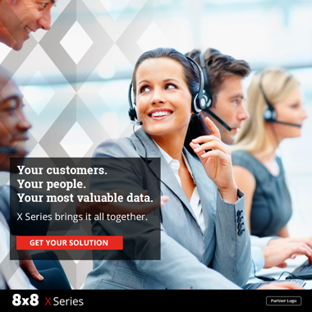
Creative Assets – Static Banner Ads – X Series Solution Overview
Notes:
And now, the 3rd wave of enterprise communications is here
■Bringing the power we have as consumers to the business
■one integrated platform for all customer AND employee interactions
■the system of engagement for contact center AND enterprise voice AND video AND chat
■access to systems of record: CRM, ERP, Help Desk
■all interaction data for more intelligent and continuous improvement of ex and cx
■One system of engagement provides the lowest TCO and transforms the employee and customer experience
■The end of “I Don’t Know” and the beginning of moving at the speed of employee and customer expectations

Slide 14
Creative Assets – Static Banner Ads – Frost & Sullivan Report
Notes:
And now, the 3rd wave of enterprise communications is here
■Bringing the power we have as consumers to the business
■one integrated platform for all customer AND employee interactions
■the system of engagement for contact center AND enterprise voice AND video AND chat
■access to systems of record: CRM, ERP, Help Desk
■all interaction data for more intelligent and continuous improvement of ex and cx
■One system of engagement provides the lowest TCO and transforms the employee and customer experience
■The end of “I Don’t Know” and the beginning of moving at the speed of employee and customer expectations

Slide 15
Creative Assets – Static Banner Ads – Gartner Magic Quadrant UCaaS Report
Notes:
And now, the 3rd wave of enterprise communications is here
■Bringing the power we have as consumers to the business
■one integrated platform for all customer AND employee interactions
■the system of engagement for contact center AND enterprise voice AND video AND chat
■access to systems of record: CRM, ERP, Help Desk
■all interaction data for more intelligent and continuous improvement of ex and cx
■One system of engagement provides the lowest TCO and transforms the employee and customer experience
■The end of “I Don’t Know” and the beginning of moving at the speed of employee and customer expectations

Slide 16
Creative Assets – Static Banner Ads – Gartner Magic Quadrant CCaaS Report
Notes:
And now, the 3rd wave of enterprise communications is here
■Bringing the power we have as consumers to the business
■one integrated platform for all customer AND employee interactions
■the system of engagement for contact center AND enterprise voice AND video AND chat
■access to systems of record: CRM, ERP, Help Desk
■all interaction data for more intelligent and continuous improvement of ex and cx
■One system of engagement provides the lowest TCO and transforms the employee and customer experience
■The end of “I Don’t Know” and the beginning of moving at the speed of employee and customer expectations

Slide 17
Creative Assets – Animated Ads – X Series Magazine
Notes:
And now, the 3rd wave of enterprise communications is here
■Bringing the power we have as consumers to the business
■one integrated platform for all customer AND employee interactions
■the system of engagement for contact center AND enterprise voice AND video AND chat
■access to systems of record: CRM, ERP, Help Desk
■all interaction data for more intelligent and continuous improvement of ex and cx
■One system of engagement provides the lowest TCO and transforms the employee and customer experience
■The end of “I Don’t Know” and the beginning of moving at the speed of employee and customer expectations

Slide 18
Creative Assets – Animated Ads – X Series Solution Overview
Notes:
And now, the 3rd wave of enterprise communications is here
■Bringing the power we have as consumers to the business
■one integrated platform for all customer AND employee interactions
■the system of engagement for contact center AND enterprise voice AND video AND chat
■access to systems of record: CRM, ERP, Help Desk
■all interaction data for more intelligent and continuous improvement of ex and cx
■One system of engagement provides the lowest TCO and transforms the employee and customer experience
■The end of “I Don’t Know” and the beginning of moving at the speed of employee and customer expectations

Slide 19
Creative Assets – Animated Ads – Frost & Sullivan Report
Notes:
And now, the 3rd wave of enterprise communications is here
■Bringing the power we have as consumers to the business
■one integrated platform for all customer AND employee interactions
■the system of engagement for contact center AND enterprise voice AND video AND chat
■access to systems of record: CRM, ERP, Help Desk
■all interaction data for more intelligent and continuous improvement of ex and cx
■One system of engagement provides the lowest TCO and transforms the employee and customer experience
■The end of “I Don’t Know” and the beginning of moving at the speed of employee and customer expectations

Slide 20
Creative Assets – Animated Ads – Gartner Magic Quadrant UCaaS Report
Notes:
And now, the 3rd wave of enterprise communications is here
■Bringing the power we have as consumers to the business
■one integrated platform for all customer AND employee interactions
■the system of engagement for contact center AND enterprise voice AND video AND chat
■access to systems of record: CRM, ERP, Help Desk
■all interaction data for more intelligent and continuous improvement of ex and cx
■One system of engagement provides the lowest TCO and transforms the employee and customer experience
■The end of “I Don’t Know” and the beginning of moving at the speed of employee and customer expectations

Slide 21
Creative Assets – Animated Ads – Gartner Magic Quadrant CCaaS Report
Notes:
And now, the 3rd wave of enterprise communications is here
■Bringing the power we have as consumers to the business
■one integrated platform for all customer AND employee interactions
■the system of engagement for contact center AND enterprise voice AND video AND chat
■access to systems of record: CRM, ERP, Help Desk
■all interaction data for more intelligent and continuous improvement of ex and cx
■One system of engagement provides the lowest TCO and transforms the employee and customer experience
■The end of “I Don’t Know” and the beginning of moving at the speed of employee and customer expectations

Slide 22
Creative Assets – Social Cards – X Series Magazine
Notes:
And now, the 3rd wave of enterprise communications is here
■Bringing the power we have as consumers to the business
■one integrated platform for all customer AND employee interactions
■the system of engagement for contact center AND enterprise voice AND video AND chat
■access to systems of record: CRM, ERP, Help Desk
■all interaction data for more intelligent and continuous improvement of ex and cx
■One system of engagement provides the lowest TCO and transforms the employee and customer experience
■The end of “I Don’t Know” and the beginning of moving at the speed of employee and customer expectations

Slide 23
Creative Assets – Social Cards – X Series Solution Overview
Notes:
And now, the 3rd wave of enterprise communications is here
■Bringing the power we have as consumers to the business
■one integrated platform for all customer AND employee interactions
■the system of engagement for contact center AND enterprise voice AND video AND chat
■access to systems of record: CRM, ERP, Help Desk
■all interaction data for more intelligent and continuous improvement of ex and cx
■One system of engagement provides the lowest TCO and transforms the employee and customer experience
■The end of “I Don’t Know” and the beginning of moving at the speed of employee and customer expectations

Slide 24
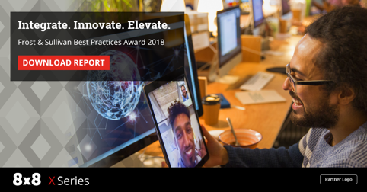
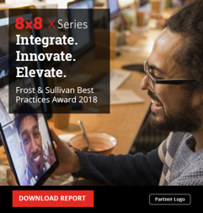
Creative Assets – Social Cards – Frost & Sullivan Report
Notes:
And now, the 3rd wave of enterprise communications is here
■Bringing the power we have as consumers to the business
■one integrated platform for all customer AND employee interactions
■the system of engagement for contact center AND enterprise voice AND video AND chat
■access to systems of record: CRM, ERP, Help Desk
■all interaction data for more intelligent and continuous improvement of ex and cx
■One system of engagement provides the lowest TCO and transforms the employee and customer experience
■The end of “I Don’t Know” and the beginning of moving at the speed of employee and customer expectations

Slide 25
Creative Assets – Social Cards – Gartner Magic Quadrant UCaaS Report
Notes:
And now, the 3rd wave of enterprise communications is here
■Bringing the power we have as consumers to the business
■one integrated platform for all customer AND employee interactions
■the system of engagement for contact center AND enterprise voice AND video AND chat
■access to systems of record: CRM, ERP, Help Desk
■all interaction data for more intelligent and continuous improvement of ex and cx
■One system of engagement provides the lowest TCO and transforms the employee and customer experience
■The end of “I Don’t Know” and the beginning of moving at the speed of employee and customer expectations

Slide 26
Creative Assets – Social Cards – Gartner Magic Quadrant CCaaS Report
Notes:
And now, the 3rd wave of enterprise communications is here
■Bringing the power we have as consumers to the business
■one integrated platform for all customer AND employee interactions
■the system of engagement for contact center AND enterprise voice AND video AND chat
■access to systems of record: CRM, ERP, Help Desk
■all interaction data for more intelligent and continuous improvement of ex and cx
■One system of engagement provides the lowest TCO and transforms the employee and customer experience
■The end of “I Don’t Know” and the beginning of moving at the speed of employee and customer expectations

Slide 27
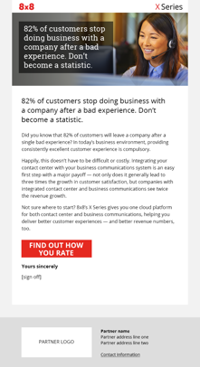
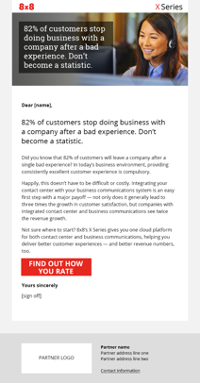
Creative Assets – Email – X Series Magazine
Notes:
And now, the 3rd wave of enterprise communications is here
■Bringing the power we have as consumers to the business
■one integrated platform for all customer AND employee interactions
■the system of engagement for contact center AND enterprise voice AND video AND chat
■access to systems of record: CRM, ERP, Help Desk
■all interaction data for more intelligent and continuous improvement of ex and cx
■One system of engagement provides the lowest TCO and transforms the employee and customer experience
■The end of “I Don’t Know” and the beginning of moving at the speed of employee and customer expectations

Slide 28
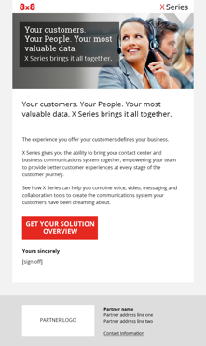
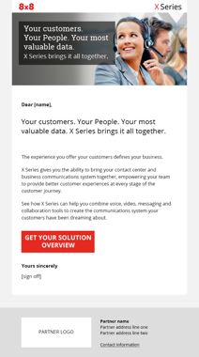
Creative Assets – Email – X Series Solution Overview
Notes:
And now, the 3rd wave of enterprise communications is here
■Bringing the power we have as consumers to the business
■one integrated platform for all customer AND employee interactions
■the system of engagement for contact center AND enterprise voice AND video AND chat
■access to systems of record: CRM, ERP, Help Desk
■all interaction data for more intelligent and continuous improvement of ex and cx
■One system of engagement provides the lowest TCO and transforms the employee and customer experience
■The end of “I Don’t Know” and the beginning of moving at the speed of employee and customer expectations

Slide 29
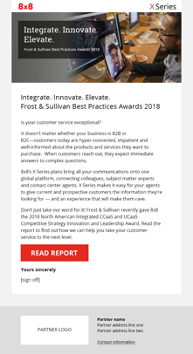
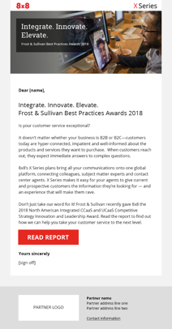
Creative Assets – Email – Frost & Sullivan Report
Notes:
And now, the 3rd wave of enterprise communications is here
■Bringing the power we have as consumers to the business
■one integrated platform for all customer AND employee interactions
■the system of engagement for contact center AND enterprise voice AND video AND chat
■access to systems of record: CRM, ERP, Help Desk
■all interaction data for more intelligent and continuous improvement of ex and cx
■One system of engagement provides the lowest TCO and transforms the employee and customer experience
■The end of “I Don’t Know” and the beginning of moving at the speed of employee and customer expectations

Slide 30
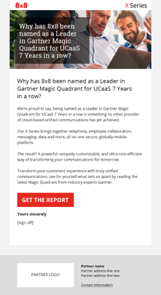
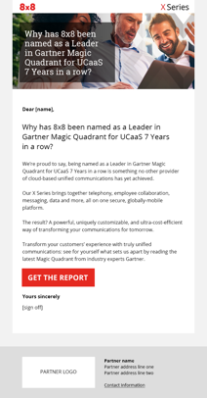
Creative Assets – Email – Gartner Magic Quadrant UCaaS Report
Notes:
And now, the 3rd wave of enterprise communications is here
■Bringing the power we have as consumers to the business
■one integrated platform for all customer AND employee interactions
■the system of engagement for contact center AND enterprise voice AND video AND chat
■access to systems of record: CRM, ERP, Help Desk
■all interaction data for more intelligent and continuous improvement of ex and cx
■One system of engagement provides the lowest TCO and transforms the employee and customer experience
■The end of “I Don’t Know” and the beginning of moving at the speed of employee and customer expectations

Slide 31
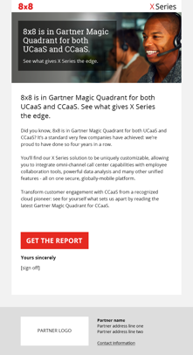
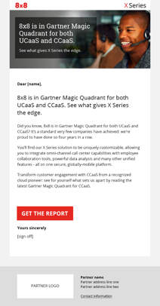
Creative Assets – Email – Gartner Magic Quadrant CCaaS Report
Notes:
And now, the 3rd wave of enterprise communications is here
■Bringing the power we have as consumers to the business
■one integrated platform for all customer AND employee interactions
■the system of engagement for contact center AND enterprise voice AND video AND chat
■access to systems of record: CRM, ERP, Help Desk
■all interaction data for more intelligent and continuous improvement of ex and cx
■One system of engagement provides the lowest TCO and transforms the employee and customer experience
■The end of “I Don’t Know” and the beginning of moving at the speed of employee and customer expectations

Slide 32
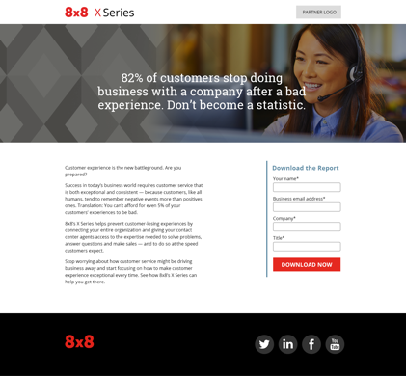
Creative Assets – Landing Page – X Series Magazine
Notes:
And now, the 3rd wave of enterprise communications is here
■Bringing the power we have as consumers to the business
■one integrated platform for all customer AND employee interactions
■the system of engagement for contact center AND enterprise voice AND video AND chat
■access to systems of record: CRM, ERP, Help Desk
■all interaction data for more intelligent and continuous improvement of ex and cx
■One system of engagement provides the lowest TCO and transforms the employee and customer experience
■The end of “I Don’t Know” and the beginning of moving at the speed of employee and customer expectations

Slide 33
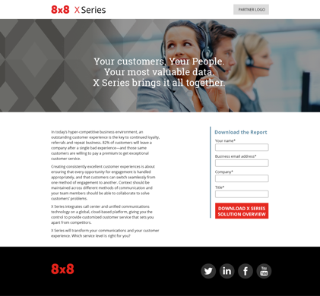
Creative Assets – Landing Page – X Series Solution Overview
Notes:
And now, the 3rd wave of enterprise communications is here
■Bringing the power we have as consumers to the business
■one integrated platform for all customer AND employee interactions
■the system of engagement for contact center AND enterprise voice AND video AND chat
■access to systems of record: CRM, ERP, Help Desk
■all interaction data for more intelligent and continuous improvement of ex and cx
■One system of engagement provides the lowest TCO and transforms the employee and customer experience
■The end of “I Don’t Know” and the beginning of moving at the speed of employee and customer expectations

Slide 34
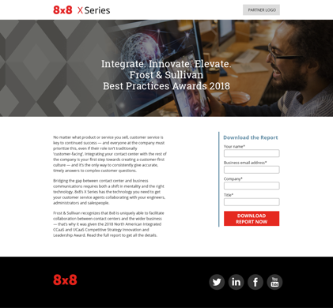
Creative Assets – Landing Page – Frost & Sullivan Report
Notes:
And now, the 3rd wave of enterprise communications is here
■Bringing the power we have as consumers to the business
■one integrated platform for all customer AND employee interactions
■the system of engagement for contact center AND enterprise voice AND video AND chat
■access to systems of record: CRM, ERP, Help Desk
■all interaction data for more intelligent and continuous improvement of ex and cx
■One system of engagement provides the lowest TCO and transforms the employee and customer experience
■The end of “I Don’t Know” and the beginning of moving at the speed of employee and customer expectations

Slide 35
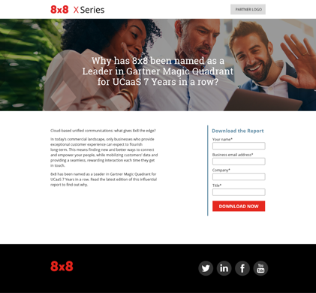
Creative Assets – Landing Page – Gartner Magic Quadrant UCaaS Report
Notes:
And now, the 3rd wave of enterprise communications is here
■Bringing the power we have as consumers to the business
■one integrated platform for all customer AND employee interactions
■the system of engagement for contact center AND enterprise voice AND video AND chat
■access to systems of record: CRM, ERP, Help Desk
■all interaction data for more intelligent and continuous improvement of ex and cx
■One system of engagement provides the lowest TCO and transforms the employee and customer experience
■The end of “I Don’t Know” and the beginning of moving at the speed of employee and customer expectations

Slide 36
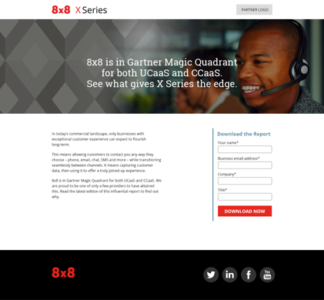
Creative Assets – Landing Page – Gartner Magic Quadrant CCaaS Report
Notes:
And now, the 3rd wave of enterprise communications is here
■Bringing the power we have as consumers to the business
■one integrated platform for all customer AND employee interactions
■the system of engagement for contact center AND enterprise voice AND video AND chat
■access to systems of record: CRM, ERP, Help Desk
■all interaction data for more intelligent and continuous improvement of ex and cx
■One system of engagement provides the lowest TCO and transforms the employee and customer experience
■The end of “I Don’t Know” and the beginning of moving at the speed of employee and customer expectations

Slide 37
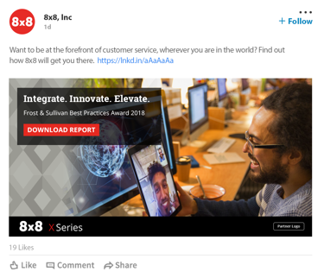
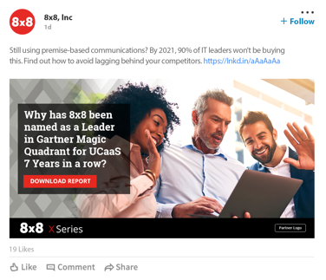
Creative Assets - Social Cards Examples of social cards for use on Twitter and LinkedIn
Notes:
And now, the 3rd wave of enterprise communications is here
■Bringing the power we have as consumers to the business
■one integrated platform for all customer AND employee interactions
■the system of engagement for contact center AND enterprise voice AND video AND chat
■access to systems of record: CRM, ERP, Help Desk
■all interaction data for more intelligent and continuous improvement of ex and cx
■One system of engagement provides the lowest TCO and transforms the employee and customer experience
■The end of “I Don’t Know” and the beginning of moving at the speed of employee and customer expectations

Slide 38
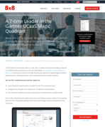
Content Assets
Gartner / UCaaS report
Gartner / CCaaS report
X Series Magazine
Frost & Sullivan report
X Series solution overview
Notes:
And now, the 3rd wave of enterprise communications is here
■Bringing the power we have as consumers to the business
■one integrated platform for all customer AND employee interactions
■the system of engagement for contact center AND enterprise voice AND video AND chat
■access to systems of record: CRM, ERP, Help Desk
■all interaction data for more intelligent and continuous improvement of ex and cx
■One system of engagement provides the lowest TCO and transforms the employee and customer experience
■The end of “I Don’t Know” and the beginning of moving at the speed of employee and customer expectations

Slide 39
Call Script
Use this call script as a discussion framework when following up on leads
1. Our Goal (What’s our goal in making contact?) | Call those contacts who clicked through to download/view the X Series campaign material, in order to confirm awareness and level of interest. Then set a first-time appointment if contact is qualified and interested in learning more. | 4. Handling Objections (What barriers are there to prevent moving the opportunity forward? What potential objections can we anticipate?) | Don’t remember receiving the emails. Didn’t read or view the downloaded materials. No time to talk right now. We don’t need anything. We’re all set. Or, we’re not ready to make a change. We just purchased. We aren’t taking on any new providers / vendors at this time. Just send me some information I’m not the right contact. (Ask who the right contact is and request to be transferred.)
2. Frame (How are we going to frame the meeting to gain the client’s agreement?) | Thank them for taking the time to look at the material. Inquire as to what they thought, questions they have, and additional information they might find of value. Qualify interest in scheduling a meeting to talk further.
3. Discovery Questions (What questions do we need to ask to get the information we require based on where we are in the sales process and the prospect’s point in the Client Buying Process?) | What triggered your interest in downloading/viewing the material? How has it influenced your view of using one cloud communications platform? How well is your current communications system meeting your company’s needs? How easy is it for your customers to reach someone who can address their queries? What’s the customer’s experience when their query requires additional assistance from other employees or departments? Does your IT team spend too much time maintaining your on- premise PBX system? What is your company’s experience of using analytics to optimize the customer experience and sales process? Would you be interested in learning more about how a cloud-based communications platform could transform your business communications? Other pain points or questions you typically ask to qualify a new prospect. Suggest setting an appointment to discuss these items in more detail. | 5. Recommend (What recommendations can we anticipate making? What information must we give the client to fill a knowledge gap and gain support?) | Make recommendations about how a cloud-based communications platform can meet their business needs more effectively and improve their customer experience. If qualified, recommend a meeting to: Continue the discussion Discuss their collaboration challenges and needs If you have helped other clients with similar challenges, share their situation and results to generate further interest in talking with you.
 |  | 6. Client’s Next Yes Step (What commitments or actions can we get?) | Agree to a specific meeting day and time, or refer you to the decision maker if they are not the correct person to meet with.
39

Slide 40
Implementation guidance
Notes:
Quick Introduction to 8x8 in UK
been in the UK since 2004; one of first players in hosted business VOIP
240 people located in London and Aylesbury; will grow another 70 or so heads in the next 12 months
All functions in UK, tightly integrated organisational on a global basis. Not just a local sales office. We are investing heavily in the best people and systems
Proven Success in leading mid market and enterprise deals eg Regus, Brent Council, Terex
So my message is you have an experienced and capable team at your disposal for thsi major project and business transformation you are going through

Slide 41
Campaign Planner
Pre-Launch | Launch Week | Week 2 | Week 3 | Week 4 | Week 5 | Post-Launch
Upload the list of contacts for this campaign to your email service. Create and test each of the 5 landing pages. Compose Email 1. Test the email format & hyperlink. | Send Email 1. Recommend sending early AM, Tues-Thurs. Monitor email opens, clicks, and downloads. Compose Email 2. Test the email format & hyperlink. Launch banner ads and social posts. | Send Email 2. Recommend sending early AM, Tues-Thurs. Monitor email opens, clicks, and downloads. Compose Email 3. Test the email format & hyperlink. | Send Email 3. Recommend sending early AM, Tues-Thurs. Monitor email opens, clicks, and downloads. Compose Email 4. Test the email format & hyperlink. | Send Email 4. Recommend sending early AM, Tues-Thurs. Monitor email opens, clicks, and downloads. Compose Email 5. Test the email format & hyperlink. | Send Email 5. Recommend sending early AM, Tues-Thurs. Monitor email opens, clicks, and downloads. | Tally the engagement (opens, clicks, and downloads) across all emails. Call the most engaged contacts to secure an appointment. The general rule is to call all contacts who have 2 or more downloads, 2 or more opens, and at least 1 download.
*Note: If you do not currently use an email automation platform, Constant Contact and MailChimp
are the most common platforms used for these campaigns.
34

Slide 42
HTML Email Instructions
General instructions
All fine (5) emails in this campaign are graphical HTML emails designed to capture the reader’s attention. Other than the limited edits identified below, no changes should be made to the design layout, images, or the HTML code.
Edit #1 - Co-branding and logo placement
Each email has a block for you to add your company logo and contact information. The layout for this block should remain consistent across all emails with the logo on the left side followed by your contact information on the right.
Edit #2 – Customizing the embedded hyperlinks
The image block for your logo has a placeholder for you to embed a link back to your home page. Additionally, the CTA (Call-to-Action) button links in emails must be replaced with a link to the landing page.
Note that both of the above changes should be performed by someone skilled in creating and editing HTML emails so as not to break any of the surrounding code. Each email has comments surrounding the lines to be edited. Once the edits have been completed and successfully tested, these comments should be deleted to ensure they don’t impact your deliverability to the inbox.

Slide 43
General Landing Page Implementation Instructions
This landing page is designed to be integrated into your website so your branding is preserved. It is also designed to alert you via email each time a visitor downloads one of the assets. You will need to provide your webmaster with the email address where you want these alerts to be delivered.
Your webmaster will need to create and test these landing pages before the emails are scheduled to be sent out. There are 2 indicators the test was successful.
The entire landing page is displayed properly with no scroll bars.
The alert email arrives in your designated email box shortly after you’ve downloaded the asset.

Slide 44
Webmaster Instructions
The HTML code for the iframes is located at the bottom of this page. The items displayed in red will need to be edited:
SIZE
The iframe will display properly without scrollbars when the width is set to 1200 and the height is set to 1750. The form is responsive so you can set the iframe to a narrower width if necessary.
At narrower widths the height may need to be changed to 2300 to prevent scrollbars from reappearing.
EMAIL PARAM
The email address should be updated to the address provided by your sales team.
Important Note: The email address must be formatted as plain text (yourmailbox@mailserverdomain.com). The email server cannot send notices to email addresses that have been encoded. Please conduct several tests to ensure you are successfully receiving the notification emails each time the web form is completed.

Slide 45
iFrame Code: Landing Page 1
The section displayed in red will need to be edited.
Landing Page 1 – X-Series Magazine
<iframesrc="https://www.8x8.com/8/why-8x8-x-series-magazine/?email=name@domain.com" name="frame1" scrolling="yes" frameborder="no" align="center"width="1200" height="1750" ></iframe>

Slide 46
iFrame Code: Landing Page 2
The section displayed in red will need to be edited.
Landing Page 2 – X Series Solution Overview
<iframesrc="https://www.8x8.com/8/why-8x8-x-series-solution-overview/?email=name@domain.com" name="frame1" scrolling="yes" frameborder="no" align="center"width="1200" height="1750" ></iframe>

Slide 47
iFrame Code: Landing Page 3
The section displayed in red will need to be edited.
Landing Page 3 – Frost & Sullivan Report
<iframesrc="https://www.8x8.com/8/why-8x8-x-series-frost-and-sullivan-report/?email=name@domain.com" name="frame1" scrolling="yes" frameborder="no" align="center"width="1200" height="1750" ></iframe>

Slide 48
iFrame Code: Landing Page 4
The section displayed in red will need to be edited.
Landing Page 4 – Gartner Magic Quadrant UCaaS Report
<iframesrc="https://www.8x8.com/8/why-8x8-x-series-gartner-mq-ucaas-report/?email=name@domain.com" name="frame1" scrolling="yes" frameborder="no" align="center"width="1200" height="1750" ></iframe>

Slide 49
iFrame Code: Landing Page 5
The section displayed in red will need to be edited.
Landing Page 5 – Gartner Magic Quadrant CCaaS Report
<iframesrc="https://www.8x8.com/8/why-8x8-x-series-gartner-mq-ccaas-report/?email=name@domain.com" name="frame1" scrolling="yes" frameborder="no" align="center"width="1200" height="1750" ></iframe>

Slide 50
Thank you
Notes:
Quick Introduction to 8x8 in UK
been in the UK since 2004; one of first players in hosted business VOIP
240 people located in London and Aylesbury; will grow another 70 or so heads in the next 12 months
All functions in UK, tightly integrated organisational on a global basis. Not just a local sales office. We are investing heavily in the best people and systems
Proven Success in leading mid market and enterprise deals eg Regus, Brent Council, Terex
So my message is you have an experienced and capable team at your disposal for thsi major project and business transformation you are going through

